Slide 1
Pancreatic Function and Glucoregulation
Notes:
Talk about what the burnt orange slide means
To setup

Slide 2
Learning Objectives
Name the cell types of the Islets of Langerhans and name the hormones secreted by them.
Describe the main targets and functions of glucagon.
List the major factors that stimulate or inhibit glucagon and insulin.
Describe the important physiological roles of insulin.
List the major actions of insulin in muscle, adipose tissue, and liver.
Explain briefly the mechanism of glucose uptake into the muscle.
Name the tissues in which insulin facilitates glucose uptake and those in which insulin does not facilitate glucose uptake.
List the major factors that stimulate or inhibit insulin secretion.
Draw an oral glucose tolerance test (oGTT) (glucose, insulin, and glucagon levels) and and describe what is occurring and why. Explain how the two hormones act to promote glucose homeostasis in the plasma.
State which nutrient storages are preferably used for short-term regulation of energy metabolism if no nutrients are available from the GI tract.
Discuss the hormones involved, fuel storage capacity, fuel storage consumption, and glucose (or fatty acid) levels during 1) the postprandial period, 2) the post-absorptive period, 3) fasting.
List the insulin-counteracting hormones and their roles in glucose homeostasis. Discuss the hormones involved in minute-to-minute regulation and long-term regulation of glucose homeostasis.

Slide 3
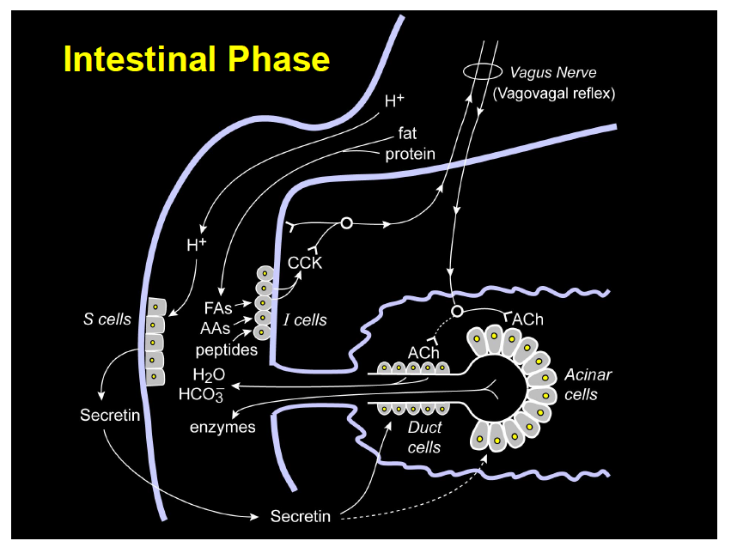
Pancreatic Secretions

Slide 4
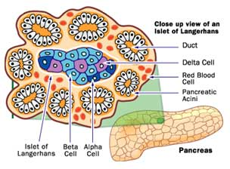
Pancreatic Anatomy
Cell | Hormone
Beta Cells | Insulin
Alpha Cells | Glucagon
Delta Cells | Somatostatin
Ductal/Acinar Cells | Exocrine
Notes:
Point out exco

Slide 5
Diabetes Mellitus
One of the first described diseases (1500 BC)
Named diabetes by Appolonius of Memphis (Egypt)
Diabetes (to pass through)
Mellitus (from honey)
Notes:
What was the other form of diabetes we discussed and what causes it?

Slide 6
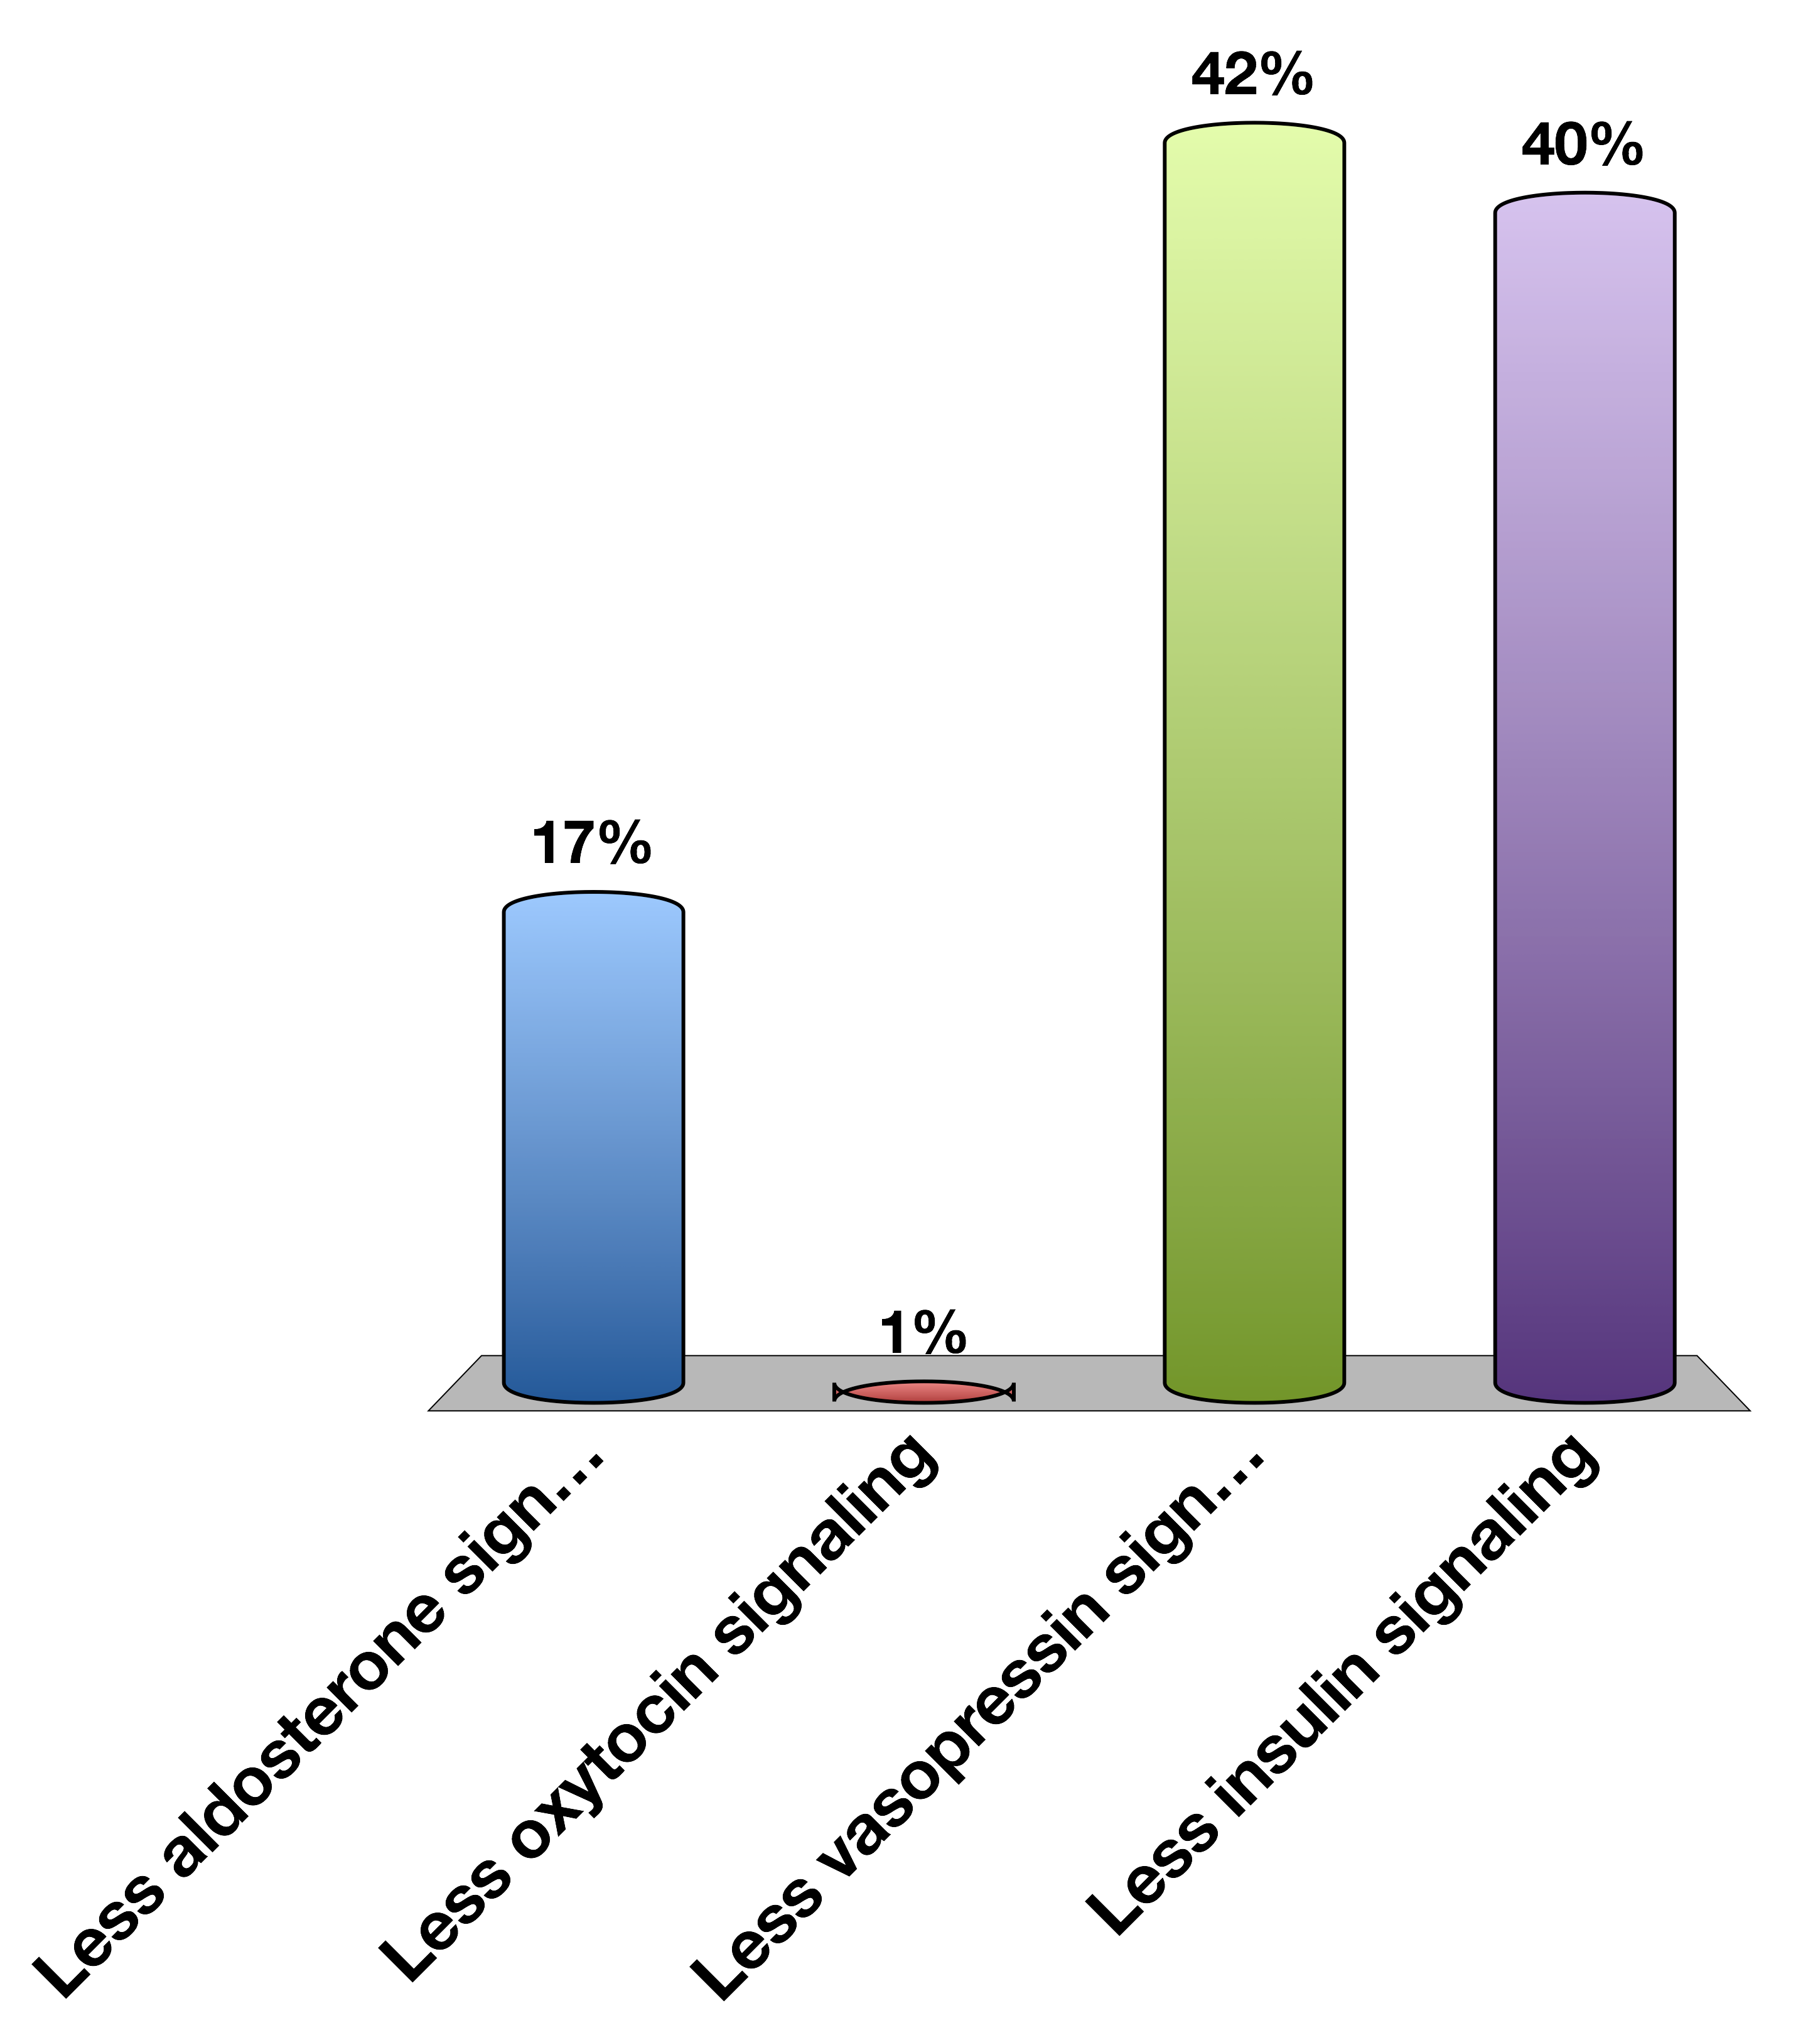
What causes diabetes insipidus
Less aldosterone signaling
Less oxytocin signaling
Less vasopressin signaling
Less insulin signaling
0

Slide 7
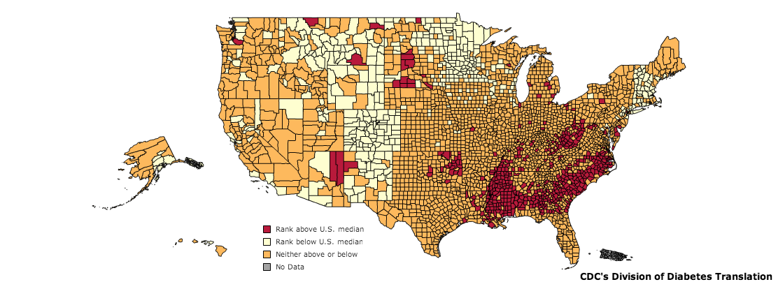
Diabetes in the United States
CDC, 2010
Notes:
As of 2011, diabetes affects 25.8 million people or 8.3% of the population. This includes approximately 7 million undiagnosed individuals. In addition to this, 79 million Americans over the age of 20 are estimated to be pre-diabetic. As of 2007, diabetes is estimated to cost $116 billion in direct and $58 billion in indirect costs [@CDC2011].
Diabetes is especially prevalent in this region. As shown in the map, there is a higher percentage of diabetics in the mid and deep south regions of the United States.

Slide 8
Complications of Diabetes
Retinopathy
Leading cause of blindness in 20-75 year olds
Nephropathy
30% to 40% of all diabetics are symptomatic
Neuropathy
risk of amputation >25 times greater than that of people without diabetes.
Cardiovascular
Heart Attack/Stroke Risk 2-4X with diabetes

Slide 9
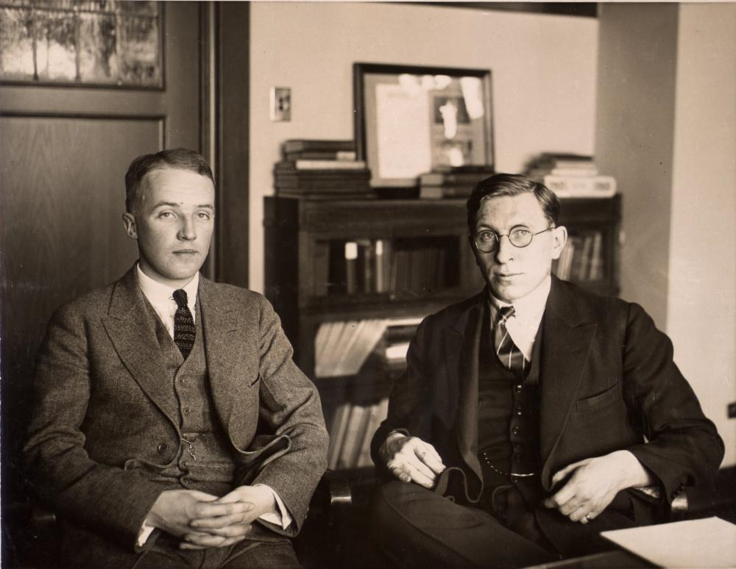
The Discovery of Insulin
Notes:
1889 von Mering and Minkowski (Pancreatectomy mimics disease)
Banting was a surgeon adept at pancreatectomizing dogs, Best was a lab technician who was very good at measuring blood glucose. MacLeod provided them lab space at the University of Toronto

Slide 10
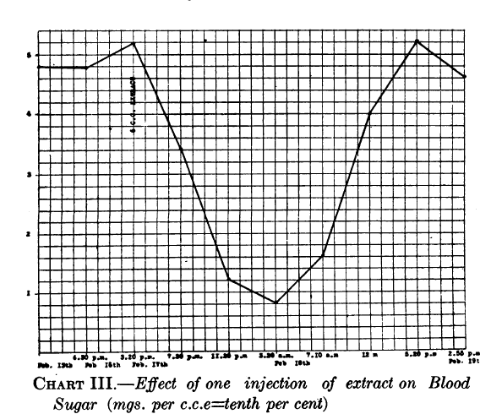
The Discovery of Insulin
Banting et al. 1922
Notes:
Insulin was discovered by Frederick Banting and his colleagues at the University of Toronto in 1921. They performed experiments in which they injected extracts
from pancreas fractions into dogs which had their pancreas’ surgically removed. They showed that a secreted substance from the pancreas lowered blood glucose
in these dogs (Frederick G. Banting and Best 1922). This is an image of dog pancreas isolate injected into a diabetic child

Slide 11
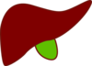

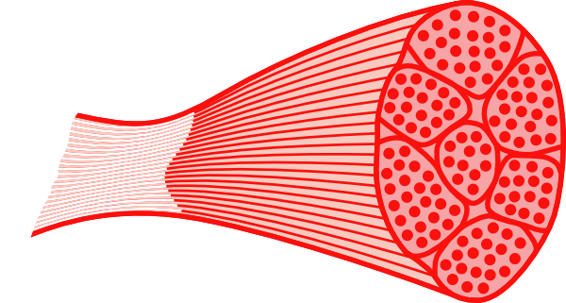
Regulation of Blood Glucose Levels
Gluconeogenesis
Disposal
Glucose Uptake
Glucose Storage
Glucose Utilization
Glucose Production
Glucose Uptake
Glucose Storage
and Utilization
Notes:
Ask for some examples of how glucose is stored, or how it is utilized

Slide 12
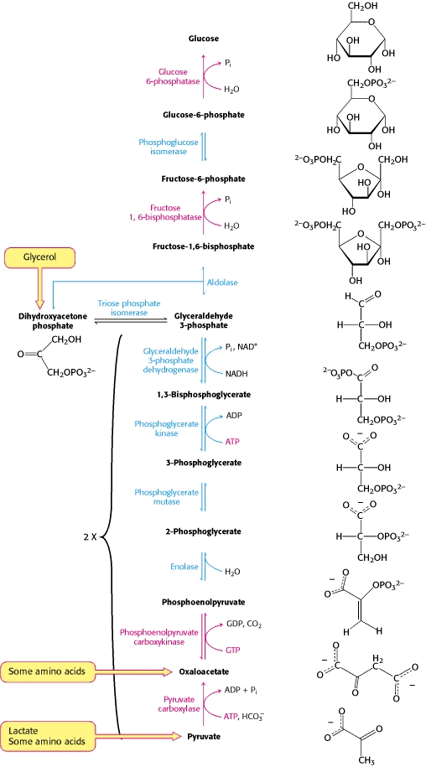
Gluconeogenesis
Uses amino acids and fatty acids to generate glucose
Key enzymes are PEPCK, FBPase and G6Pase
Notes:
Where does this mainly occur

Slide 13
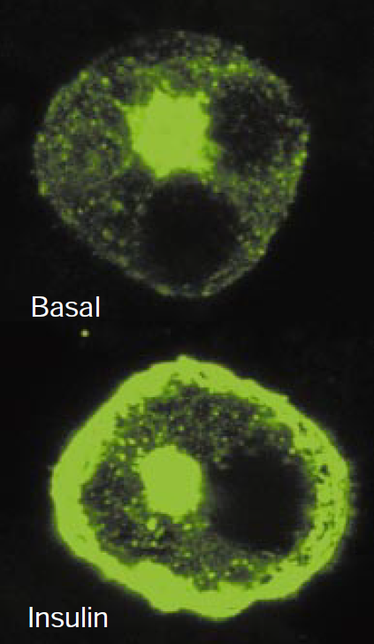
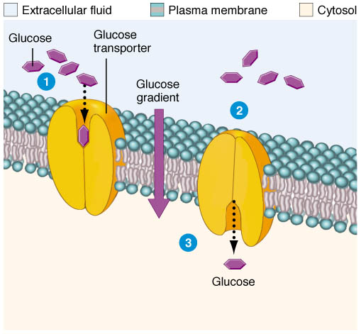
Glucose Uptake
Passive Glucose Uptake
Stimulated Glucose Uptake
Brain
Liver
Kidneys
Fat
Muscle
GLUT4-eGFP
From Saltiel and Kahn (2001) Nature 414:799-806
From http://classroom.sdmesa.edu/eschmid/Chapter3-Zoo145.htm
Notes:
Point out that it travels down a passive diffusion gradient into the cell once GLUT4 is there

Slide 14
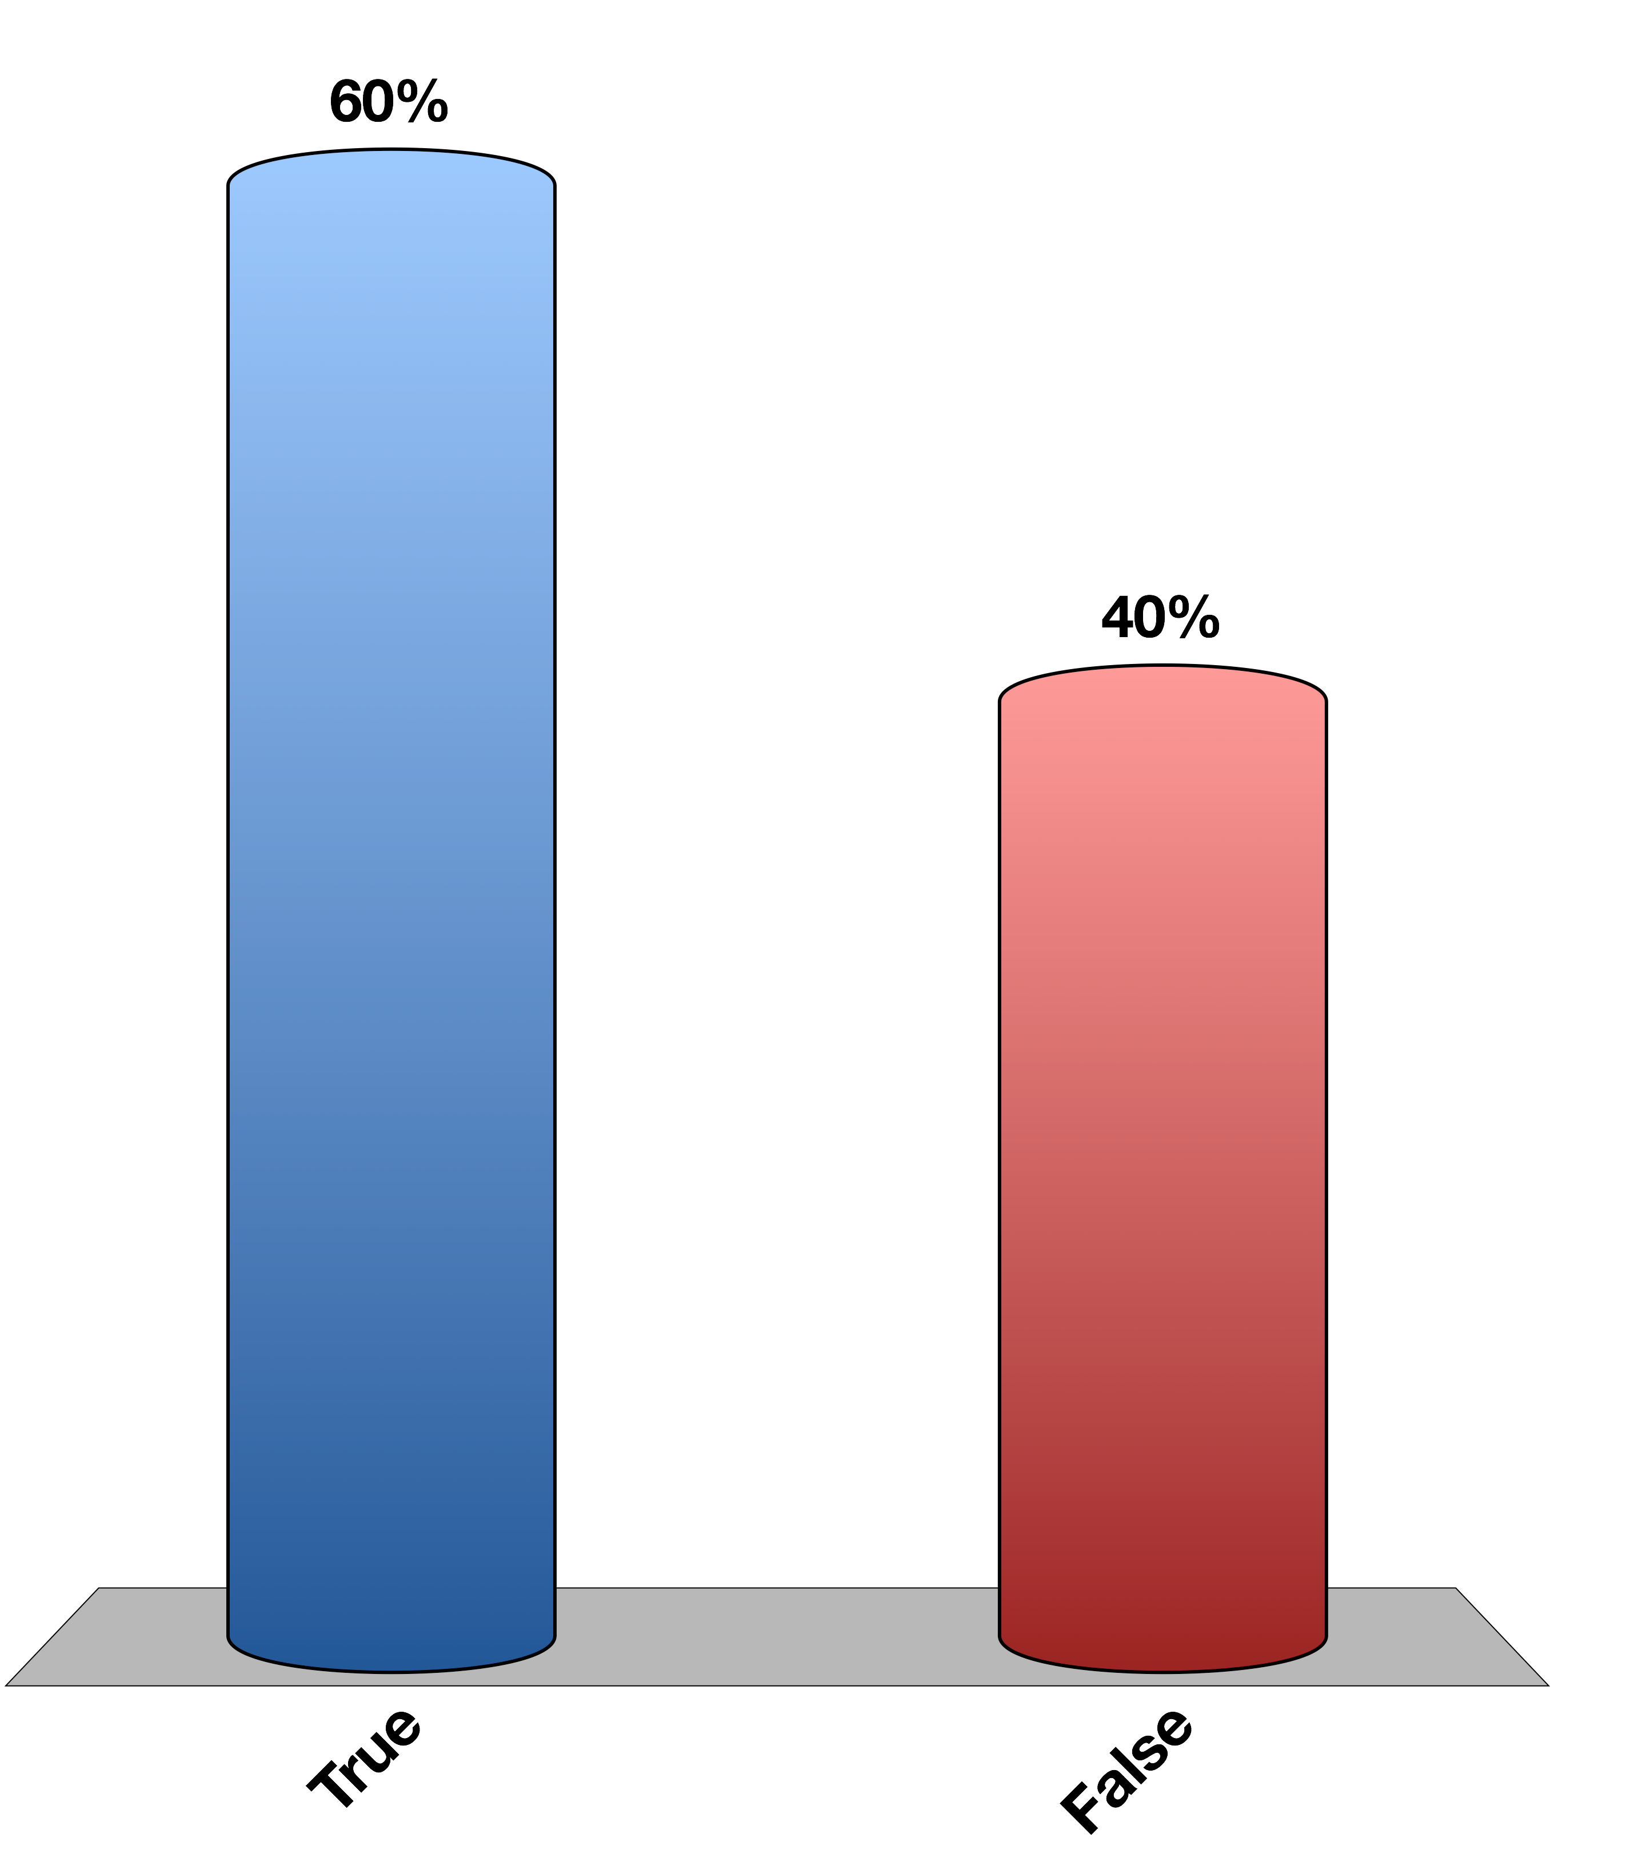
Glucose Uptake into Adipose/Muscle is Via Active Transport
True
False
0
Notes:
FALSE -> due to passive diffusion

Slide 15
Once Glucose is in the cell
Burned as fuel (muscle/brain)
Stored as glycogen (muscle/liver/kidney)
Converted to triglycerides (adipose)

Slide 16
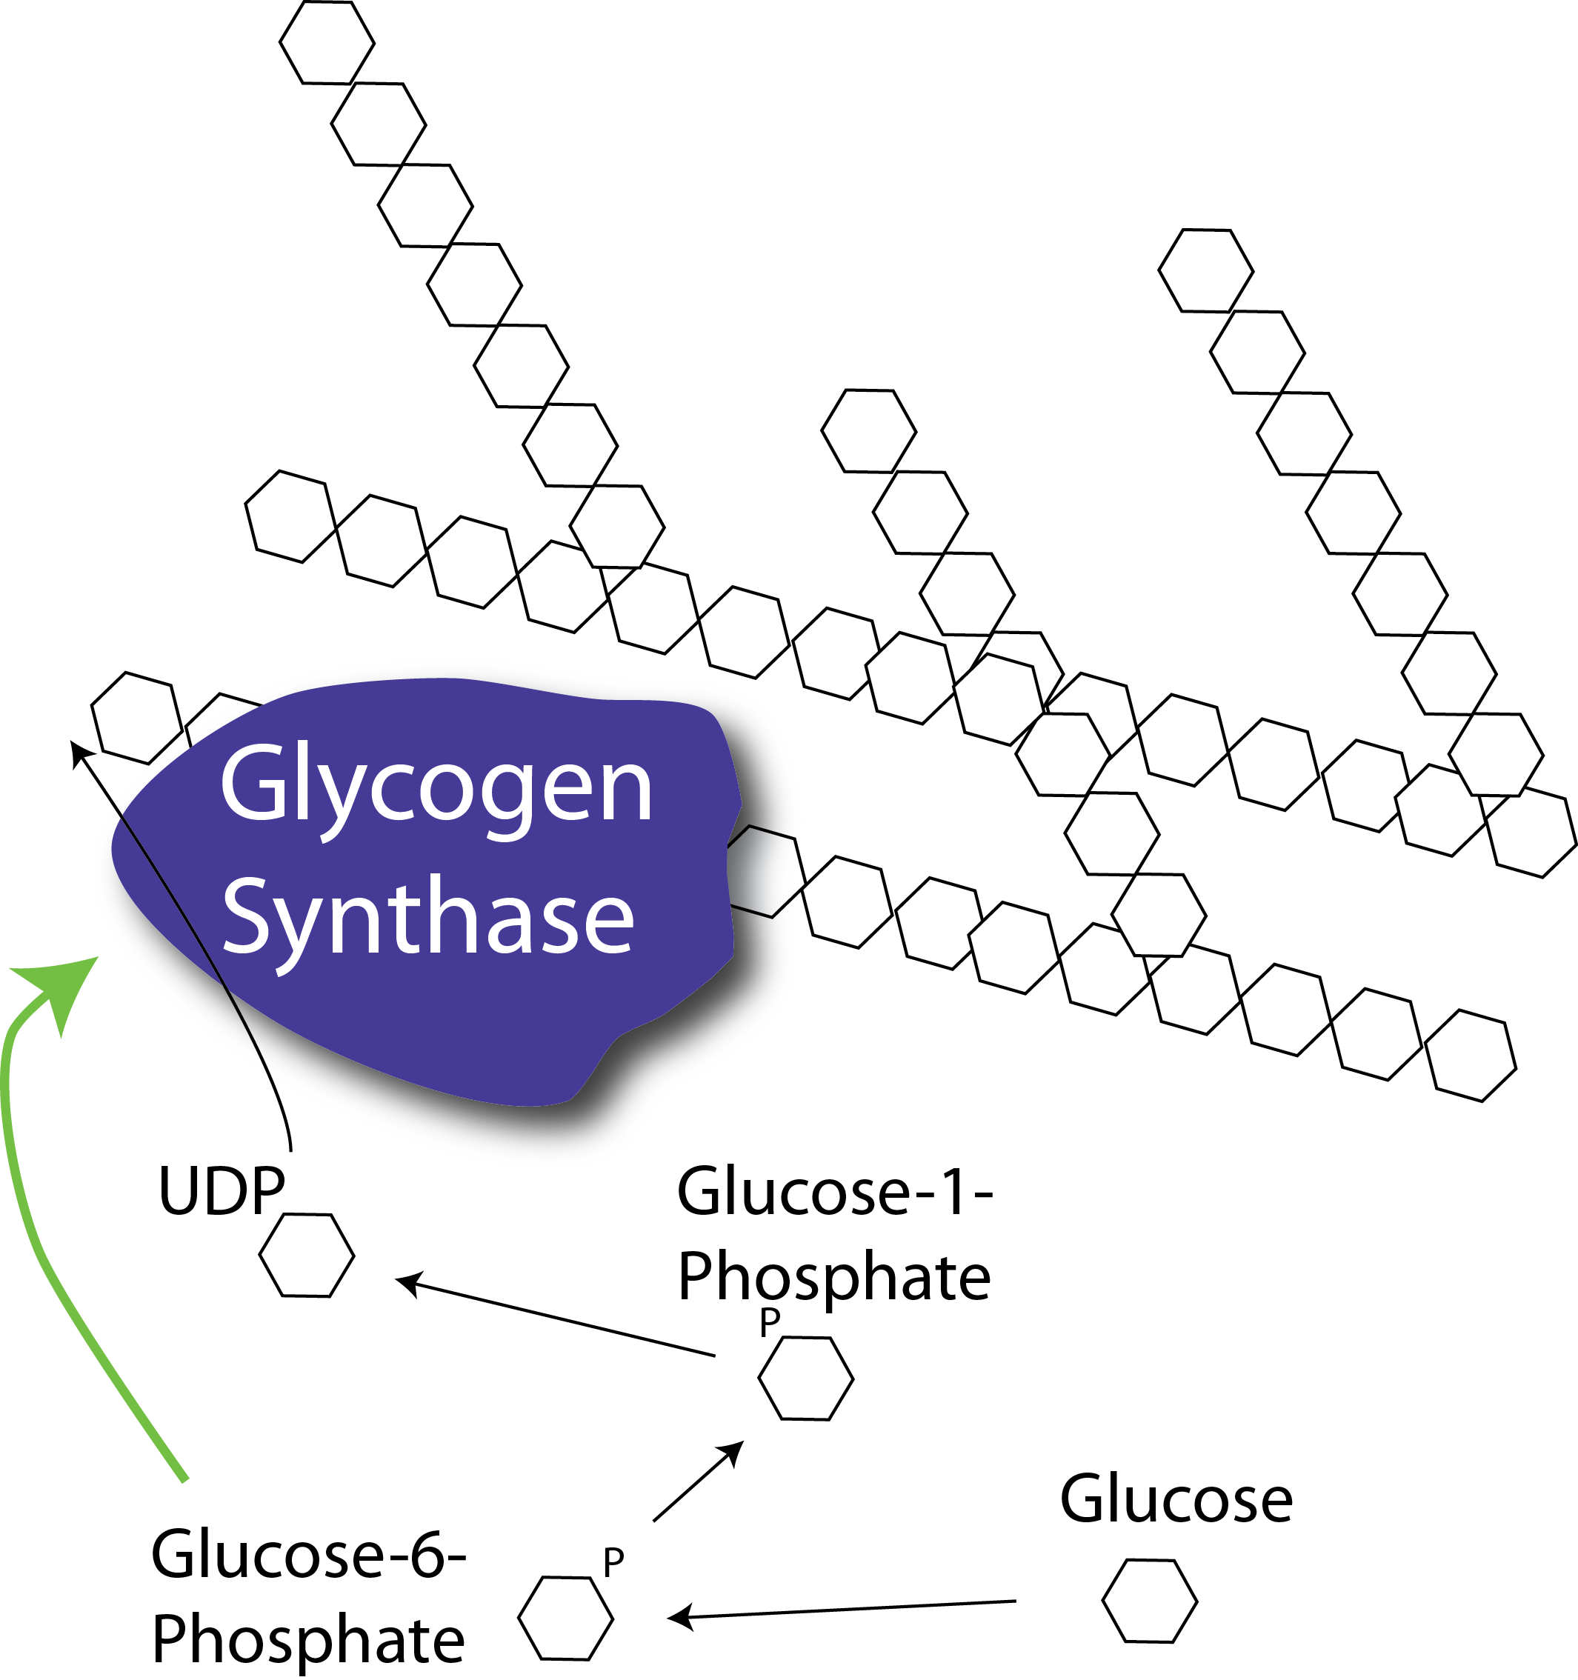
Glycogenesis
Notes:
Rate limiting step is the regulation of glycogen synthase activity.
Allosterically activated by Glucose-6-Phosphate, which is increased during glucose uptake and glycolytic flux

Slide 17
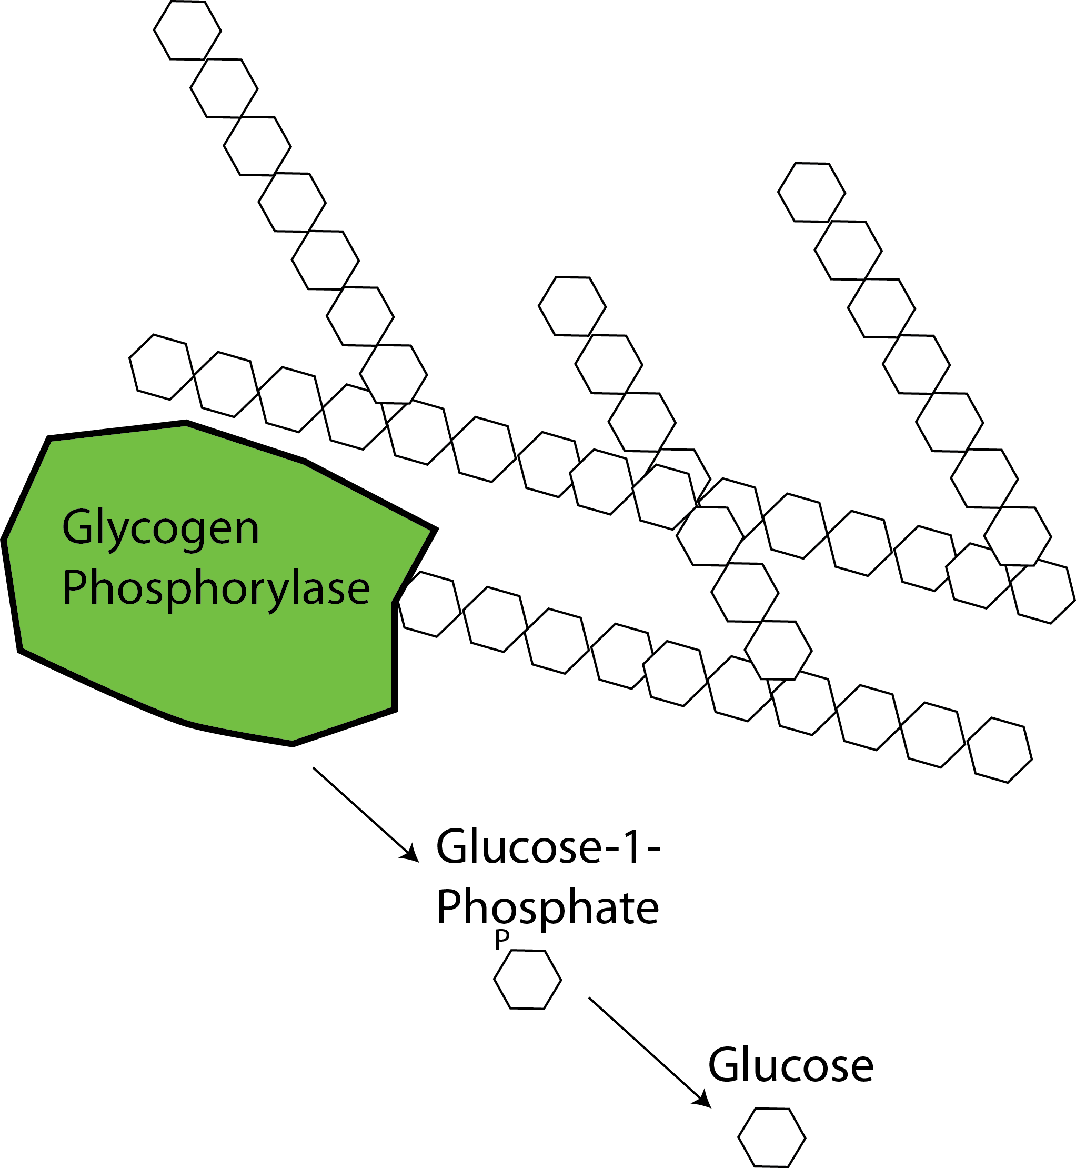
Glycogenolysis

Slide 18
Mechanisms to Reduce Blood Glucose

Slide 19

Functions of Insulin
Promotes the uptake of glucose from the blood into muscle and adipose tissue.
Enhances the synthesis of glycogen and triglycerides in liver, adipose and muscle.
Insulin inhibits gluconeogenesis, or the production of glucose from non-glucose precursors such as amino acids and lipids.
Promote glucose breakdown and prevent lipid breakdown
Food
Circulating
Nutrients
(Glucose)
Glucose Production
Glucose Disposal
Insulin
Secretion
Nutrient Storage

Slide 20
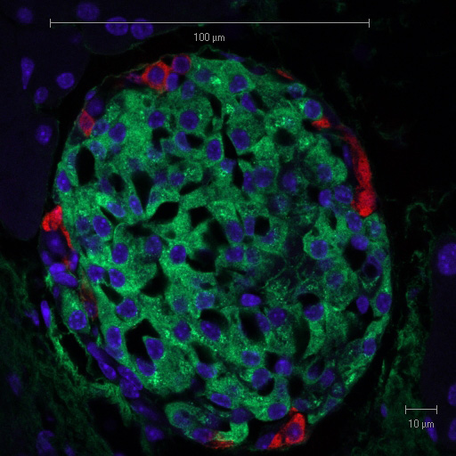
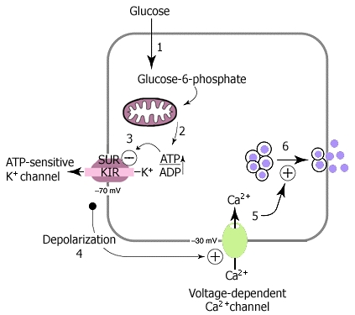
Insulin Secretion
Suckale and Solimena (2008) Frontiers in bioscience 13:7156-71
Pancreatic Islet with Glucagon and Insulin Staining
From Solilema Lab (http://en.wikipedia.org/wiki/Islets_of_Langerhans)
Notes:
Red is glucagon, green is insulin
What happens if you cannot secrete insulin from beta cells?

Slide 21
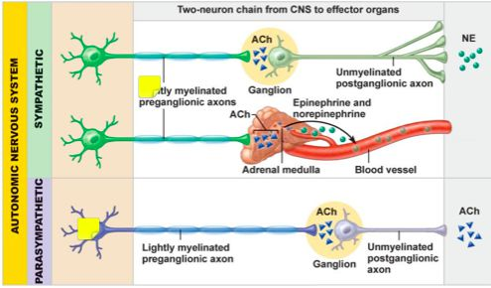
Nervous Control of Pancreatic Function
More Glucagon
Less Insulin
More Insulin
Less Glucagon
Notes:
Independent of blood glucose, what would exercise do to insulin and glucagon levels

Slide 22
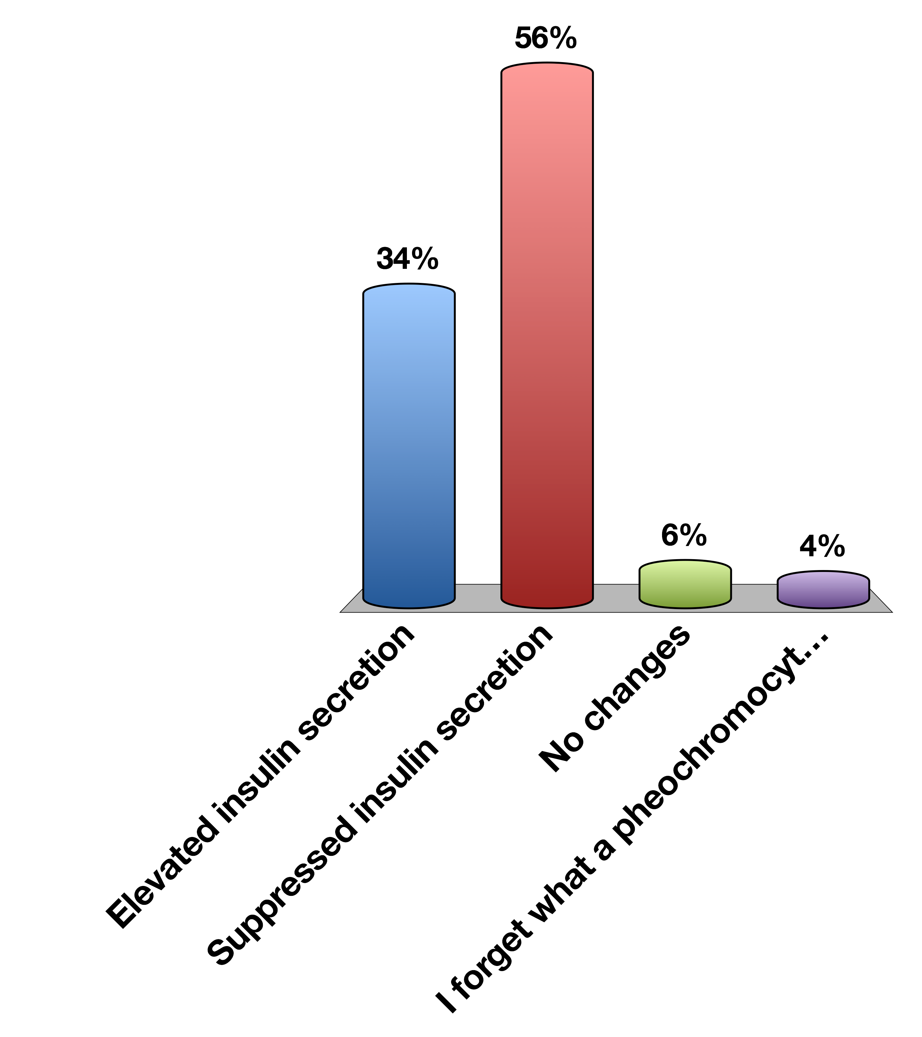
A patient with a pheochromocytoma should have
Elevated insulin secretion
Suppressed insulin secretion
No changes
I forget what a pheochromocytoma is
0
Notes:
Answer is B

Slide 23
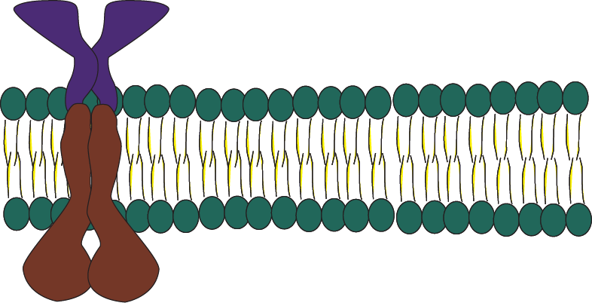
Insulin Signaling – PI3K Signaling
Insulin
P
P
IRS
PI(4,5)P₂
PI(3,4,5)P₃
p85
P
P
P
p110
P
P
P
Class I PI3K
Akt

Slide 24
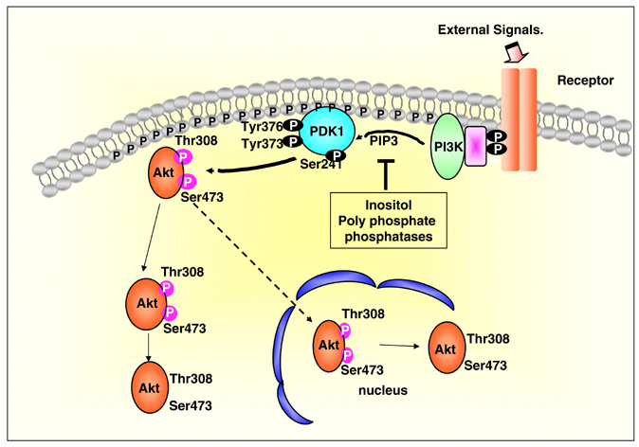
Akt is the primary mediator of insulin action
mTORC2
Notes:
Virtually all relevant insulin signaling requires the activation of Akt
Make sure to mention that all of these phosphorylation events can be reversed by protein phosphatases

Slide 25
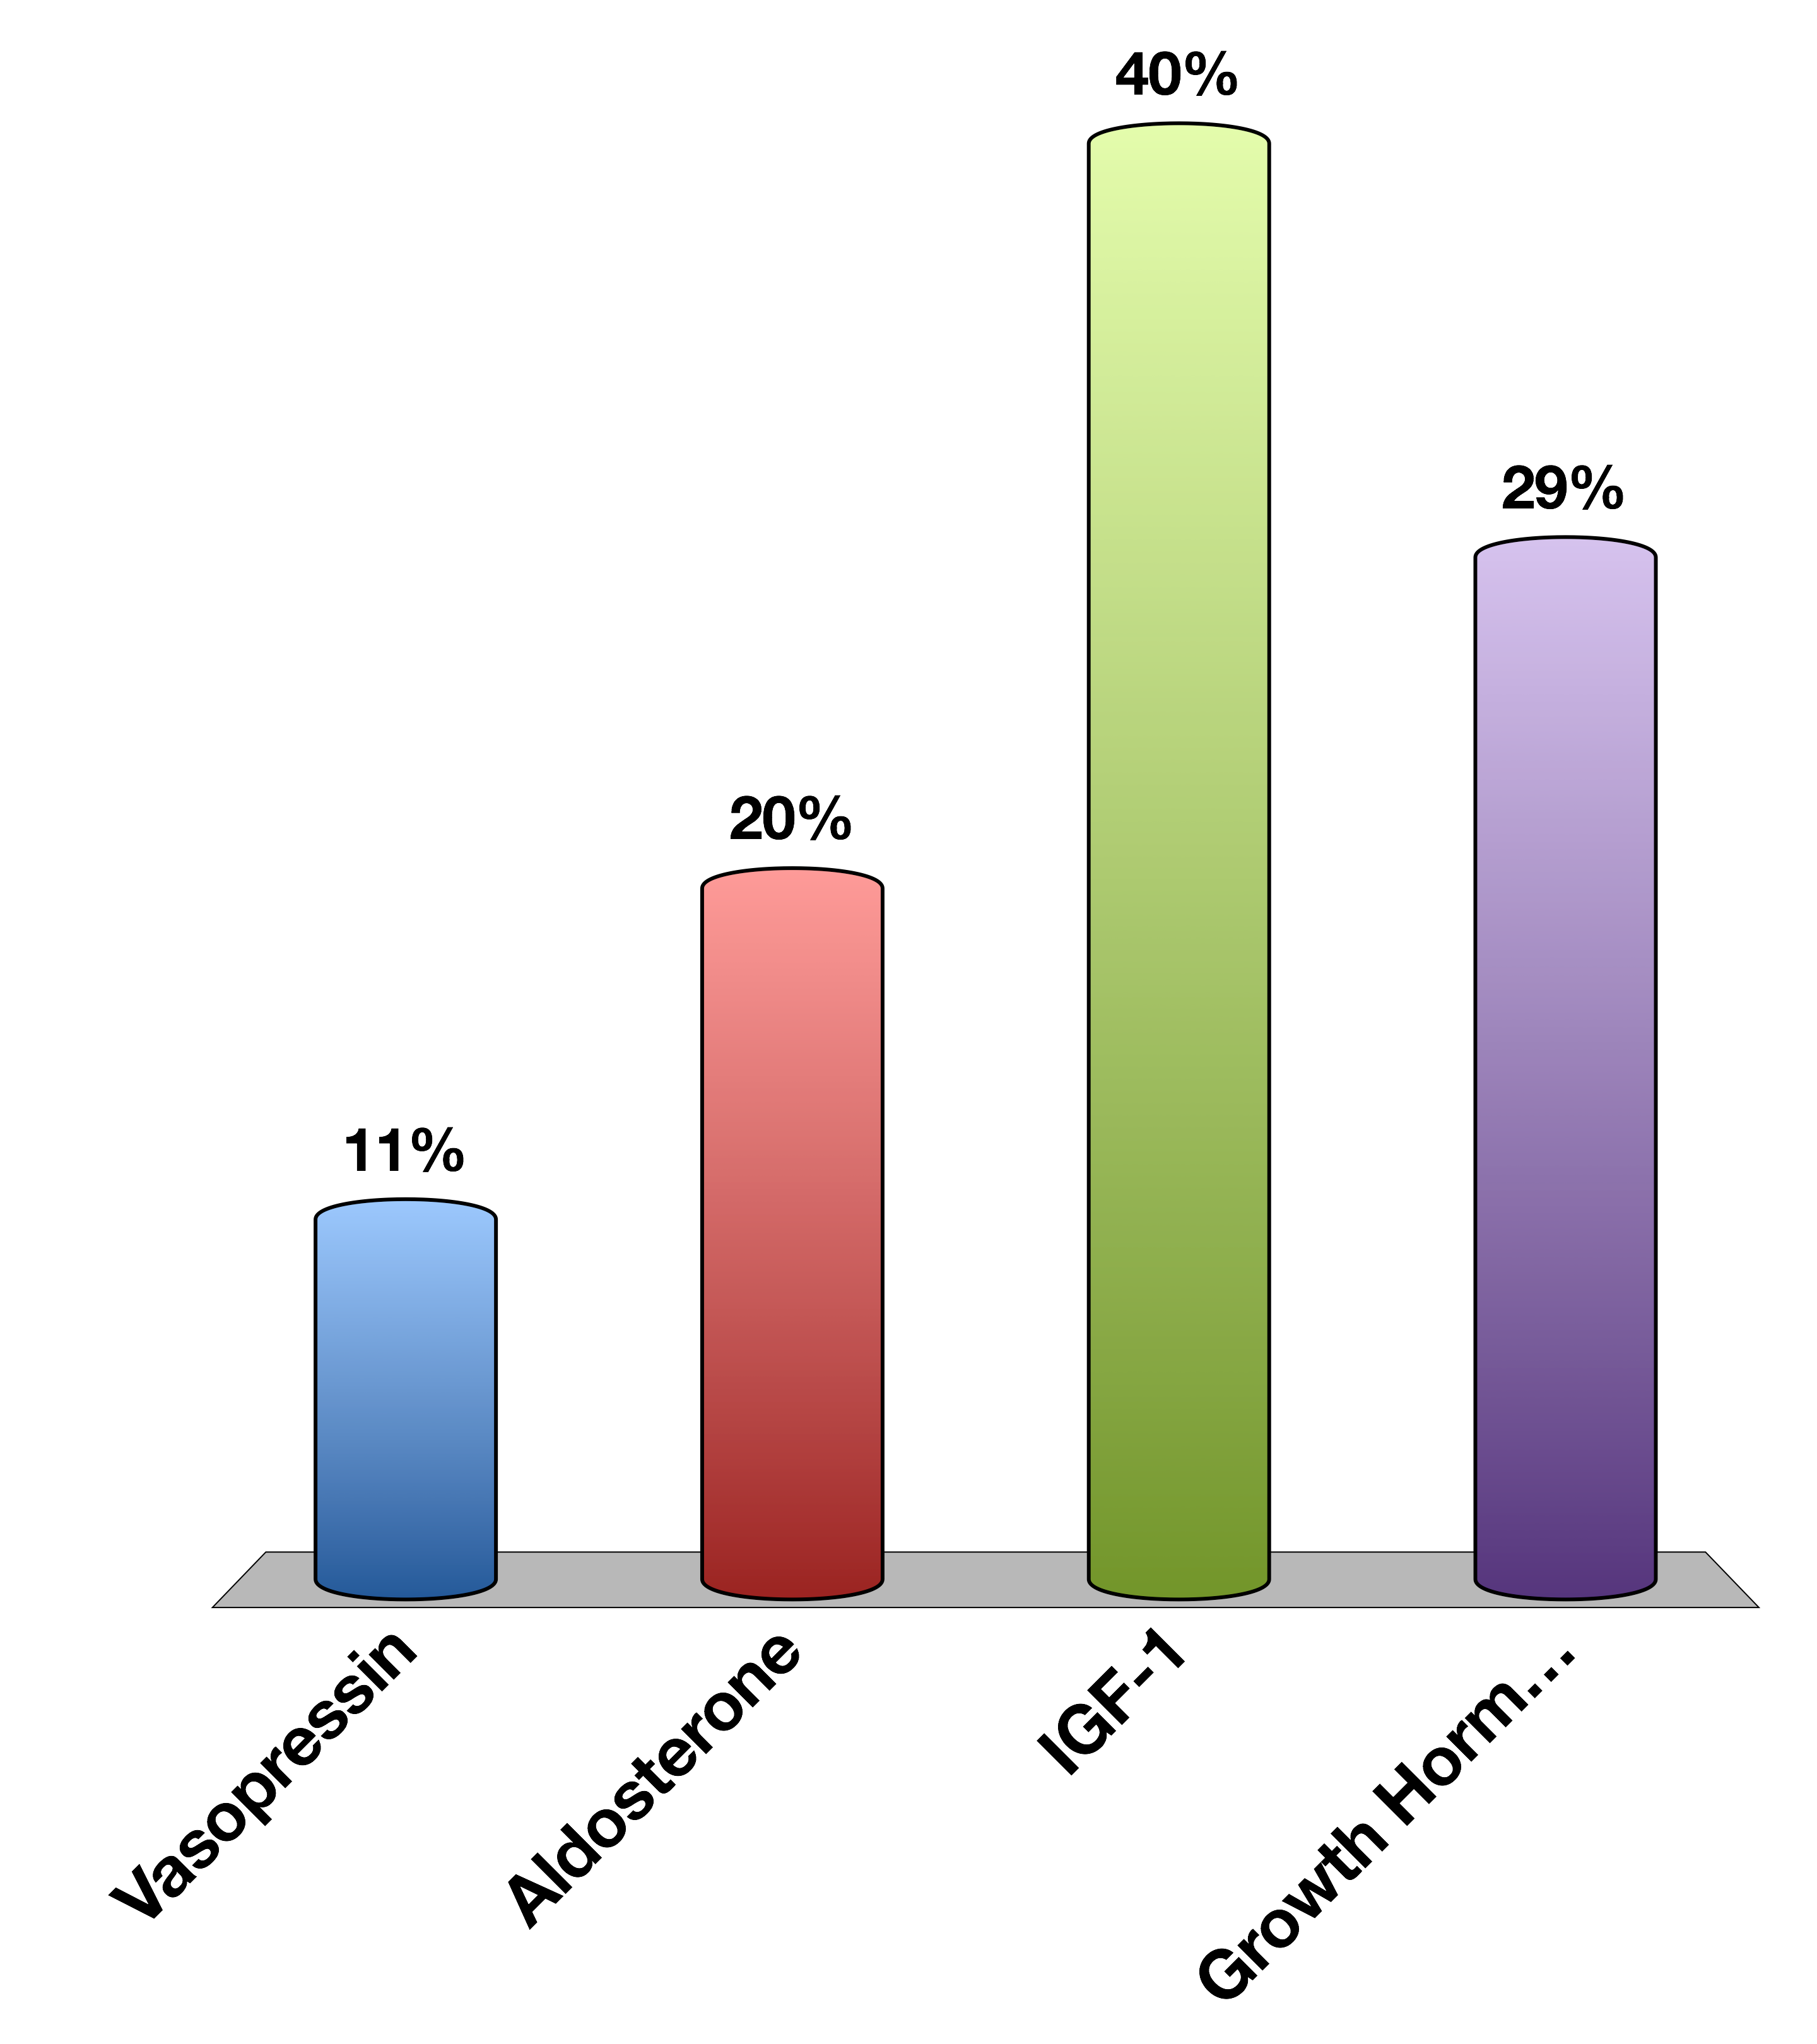
What other hormone that we have discussed uses a tyrosine kinase signaling cascade?
Vasopressin
Aldosterone
IGF-1
Growth Hormone
0
Notes:
Answer is C

Slide 26
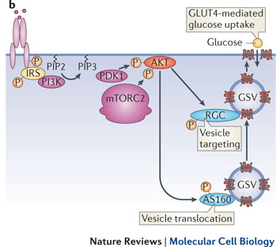
Insulin Stimulated GLUT4 Translocation
Leto and Saltiel Nat. Rev. MCB (2012)

Slide 27
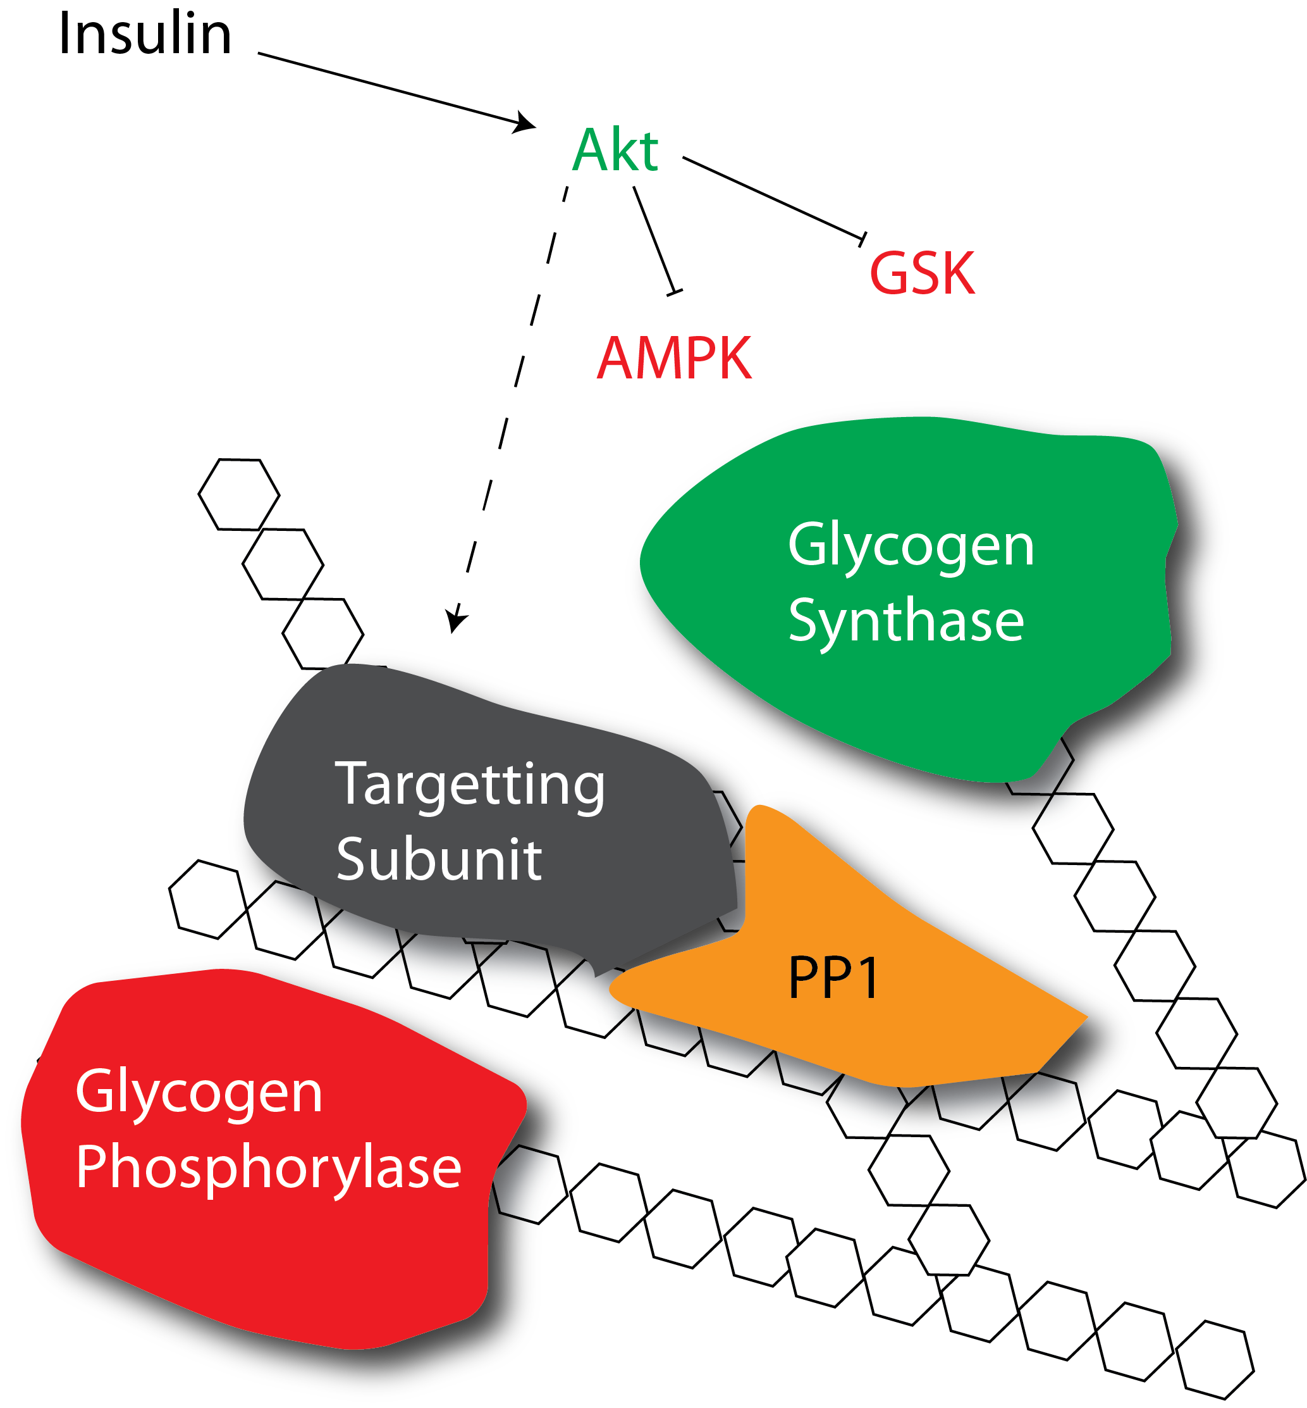
How does insulin promote glycogenesis?
Allosteric activation
Protein dephosphorylation
Notes:
First ask about which mediators are increased with insulin, or see what the allosteric activation of GS looks like

Slide 28
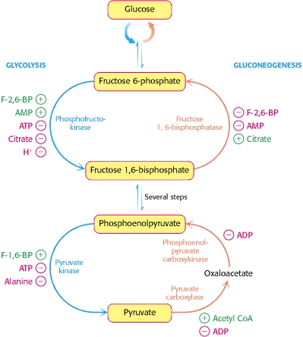
How does insulin reduce gluconeogenesis
FBPase is negatively regulated by F-2,6-BP
PEPCK and G6Pase are inhibited by insulin
Allosterically
Protein phosphorylation
Transcriptionally repressed
Notes:
First, does insulin promote or reduce gluconeogenesis

Slide 29
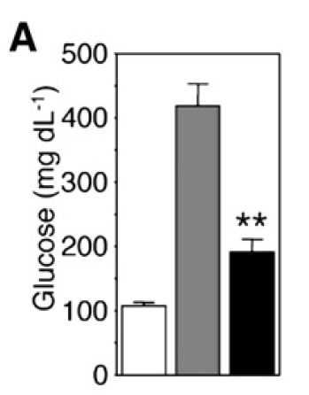
Transcriptional Regulation of Gluconeogenesis
Akt
PEPCK
G6Pase
P
Knockout
IR
IR +
FOXO
FOXO
P
P
Matsumoto et al. (2007) Cell Metab. 6:208-16

Slide 30
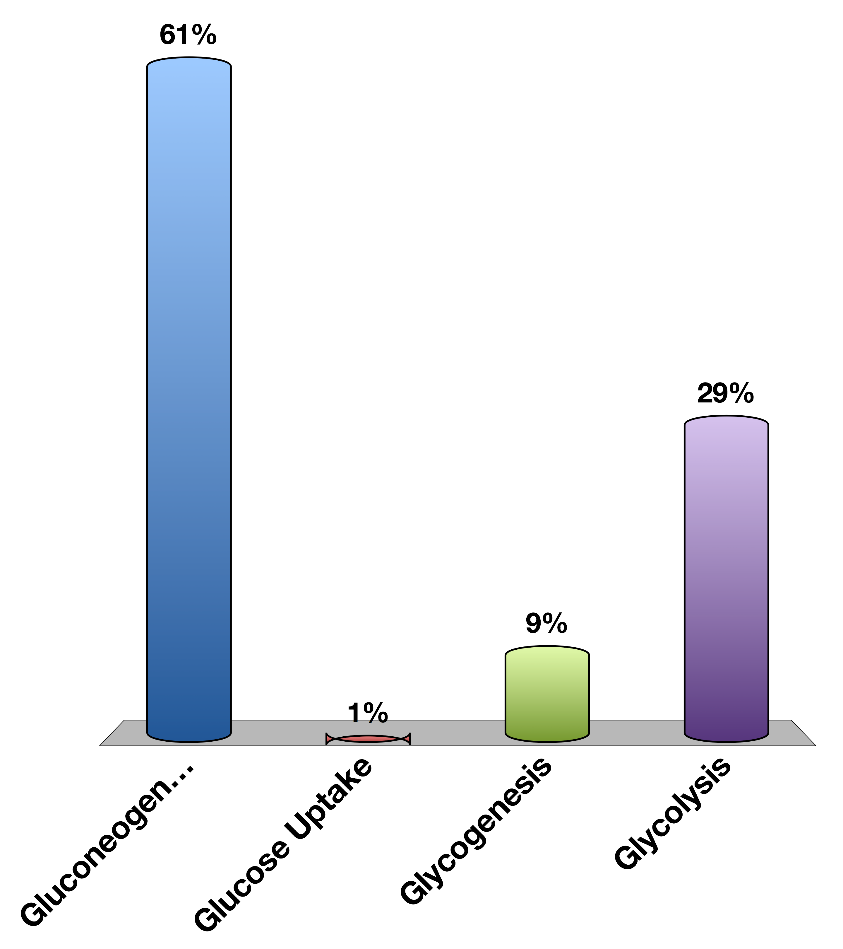
What does insulin NOT activate?
Gluconeogenesis
Glucose Uptake
Glycogenesis
Glycolysis
0

Slide 31
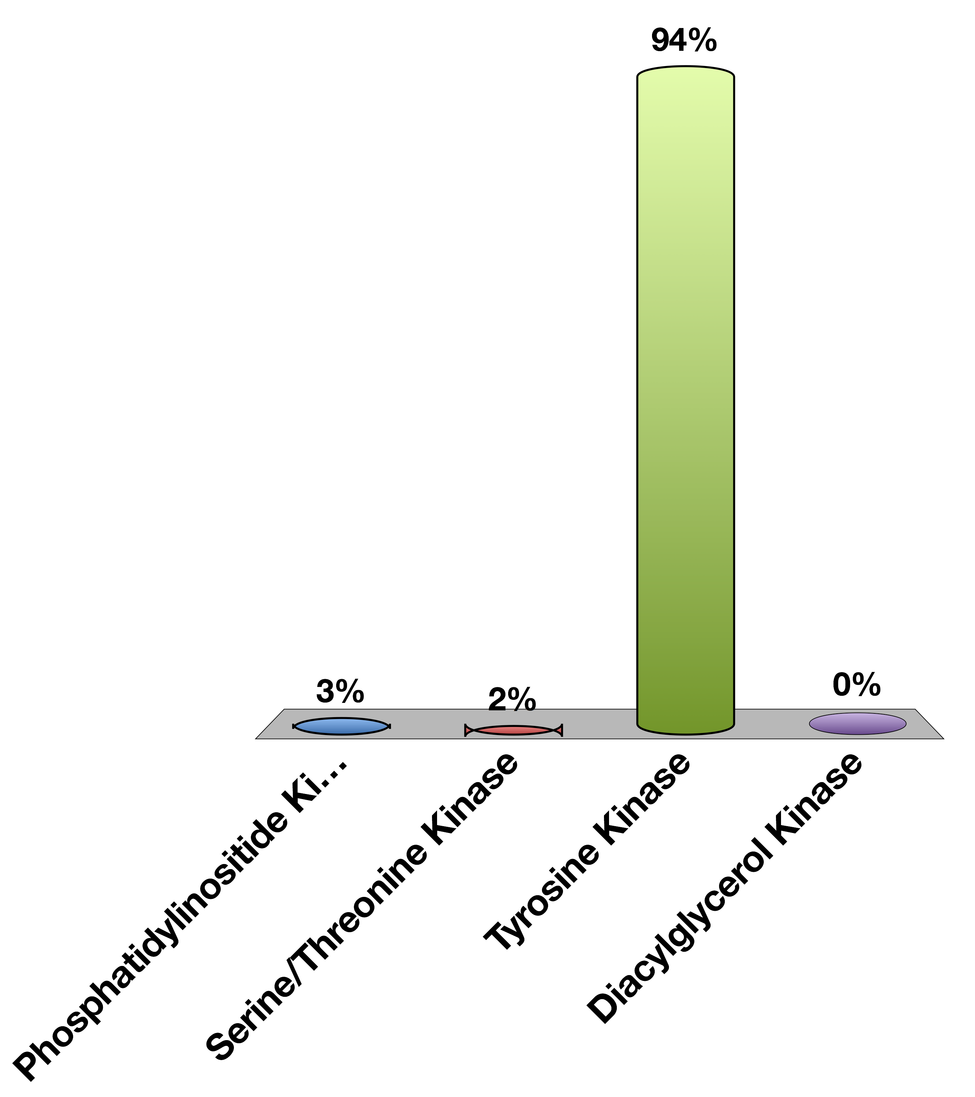
The Insulin Receptor is a…
Phosphatidylinositide Kinase
Serine/Threonine Kinase
Tyrosine Kinase
Diacylglycerol Kinase
0

Slide 32
Mechanisms to Increase Blood Glucose

Slide 33
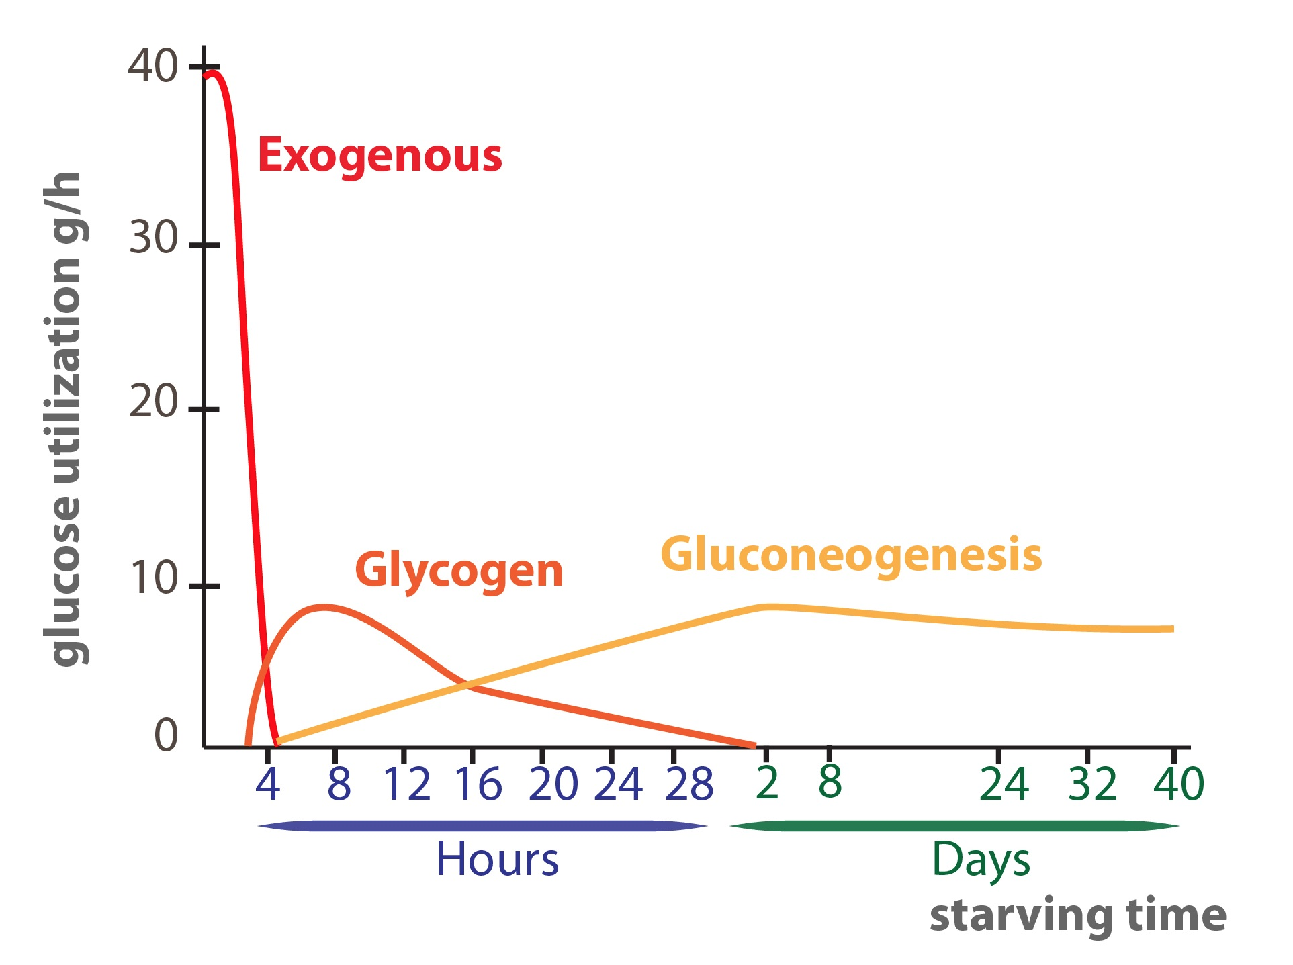
Sources of Blood Glucose in Fasting

Slide 34
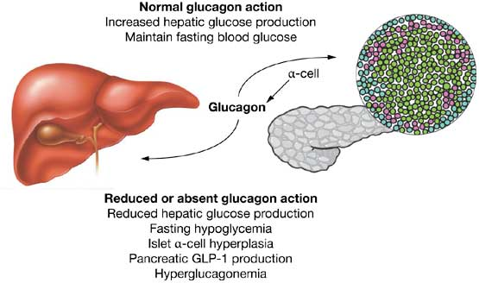
Glucagon Secretion
Secreted from alpha cells of the pancreas
Released by low blood sugar levels
Acts mainly on the liver not the muscle or fat tissues
Drucker (2013): Nat Rev Endo 1:22-31

Slide 35
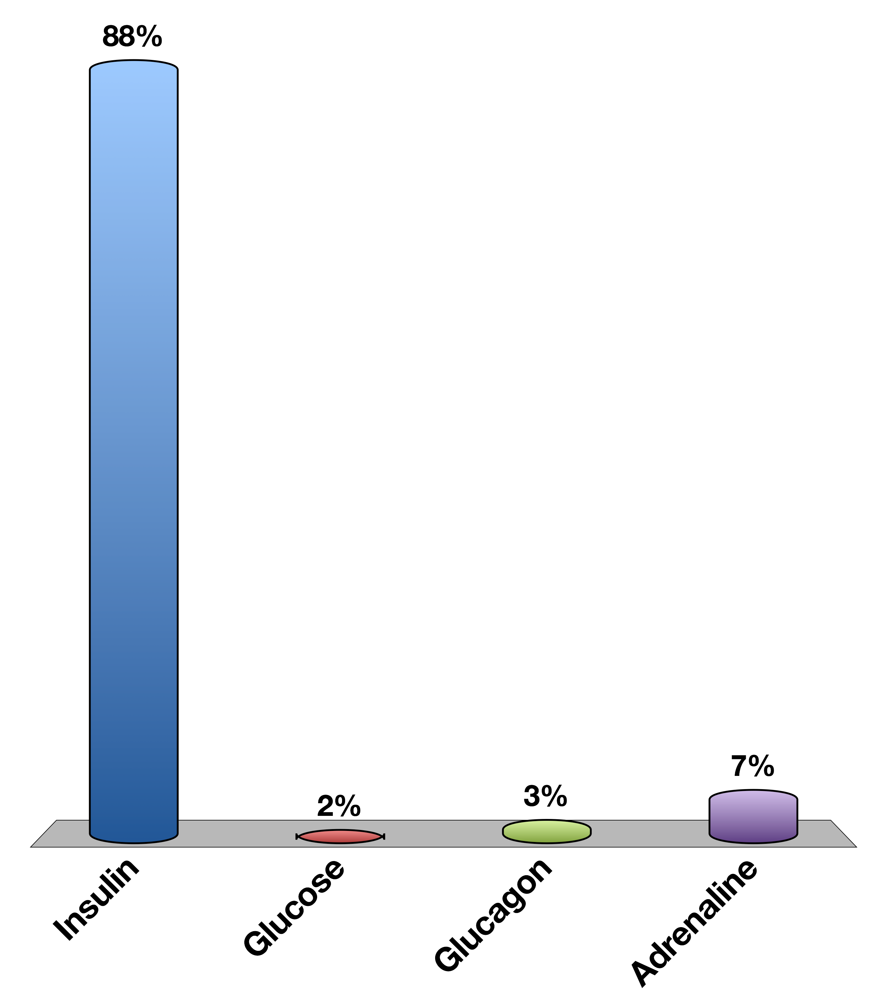
A patient is rushed to the hospital with low blood glucose, what would be a bad treatment?
Insulin
Glucose
Glucagon
Adrenaline
0

Slide 36
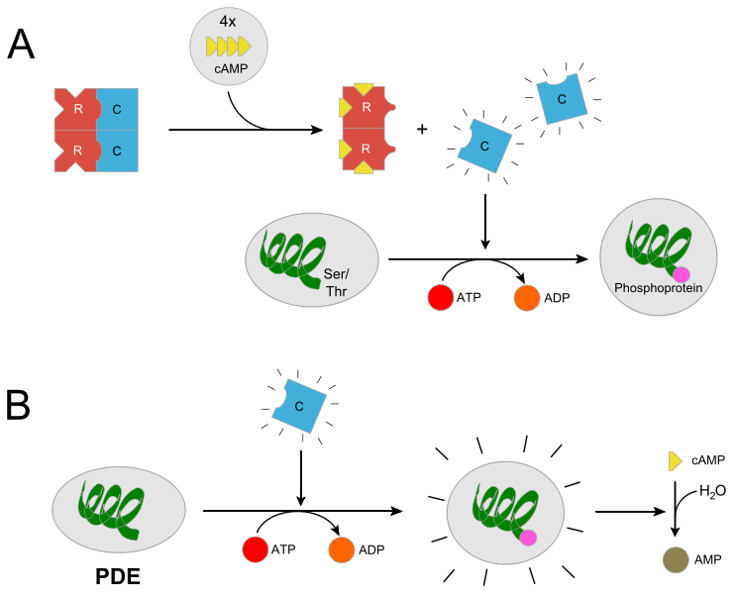
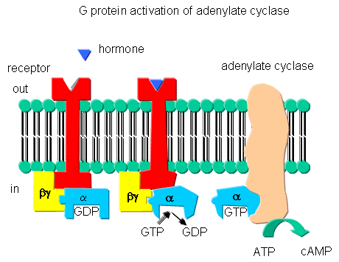
Glucagon Signaling
From http://biowiki.ucdavis.edu/Biochemistry/Signal_Transduction/Signal_Transduction_at_Cell_Membranes%3A_Protein_Kinases_and_Phosphotases
From http://en.wikipedia.org/wiki/Protein_kinase_A
Notes:
Potentially spend some time on earl sutherland’s experiments

Slide 37
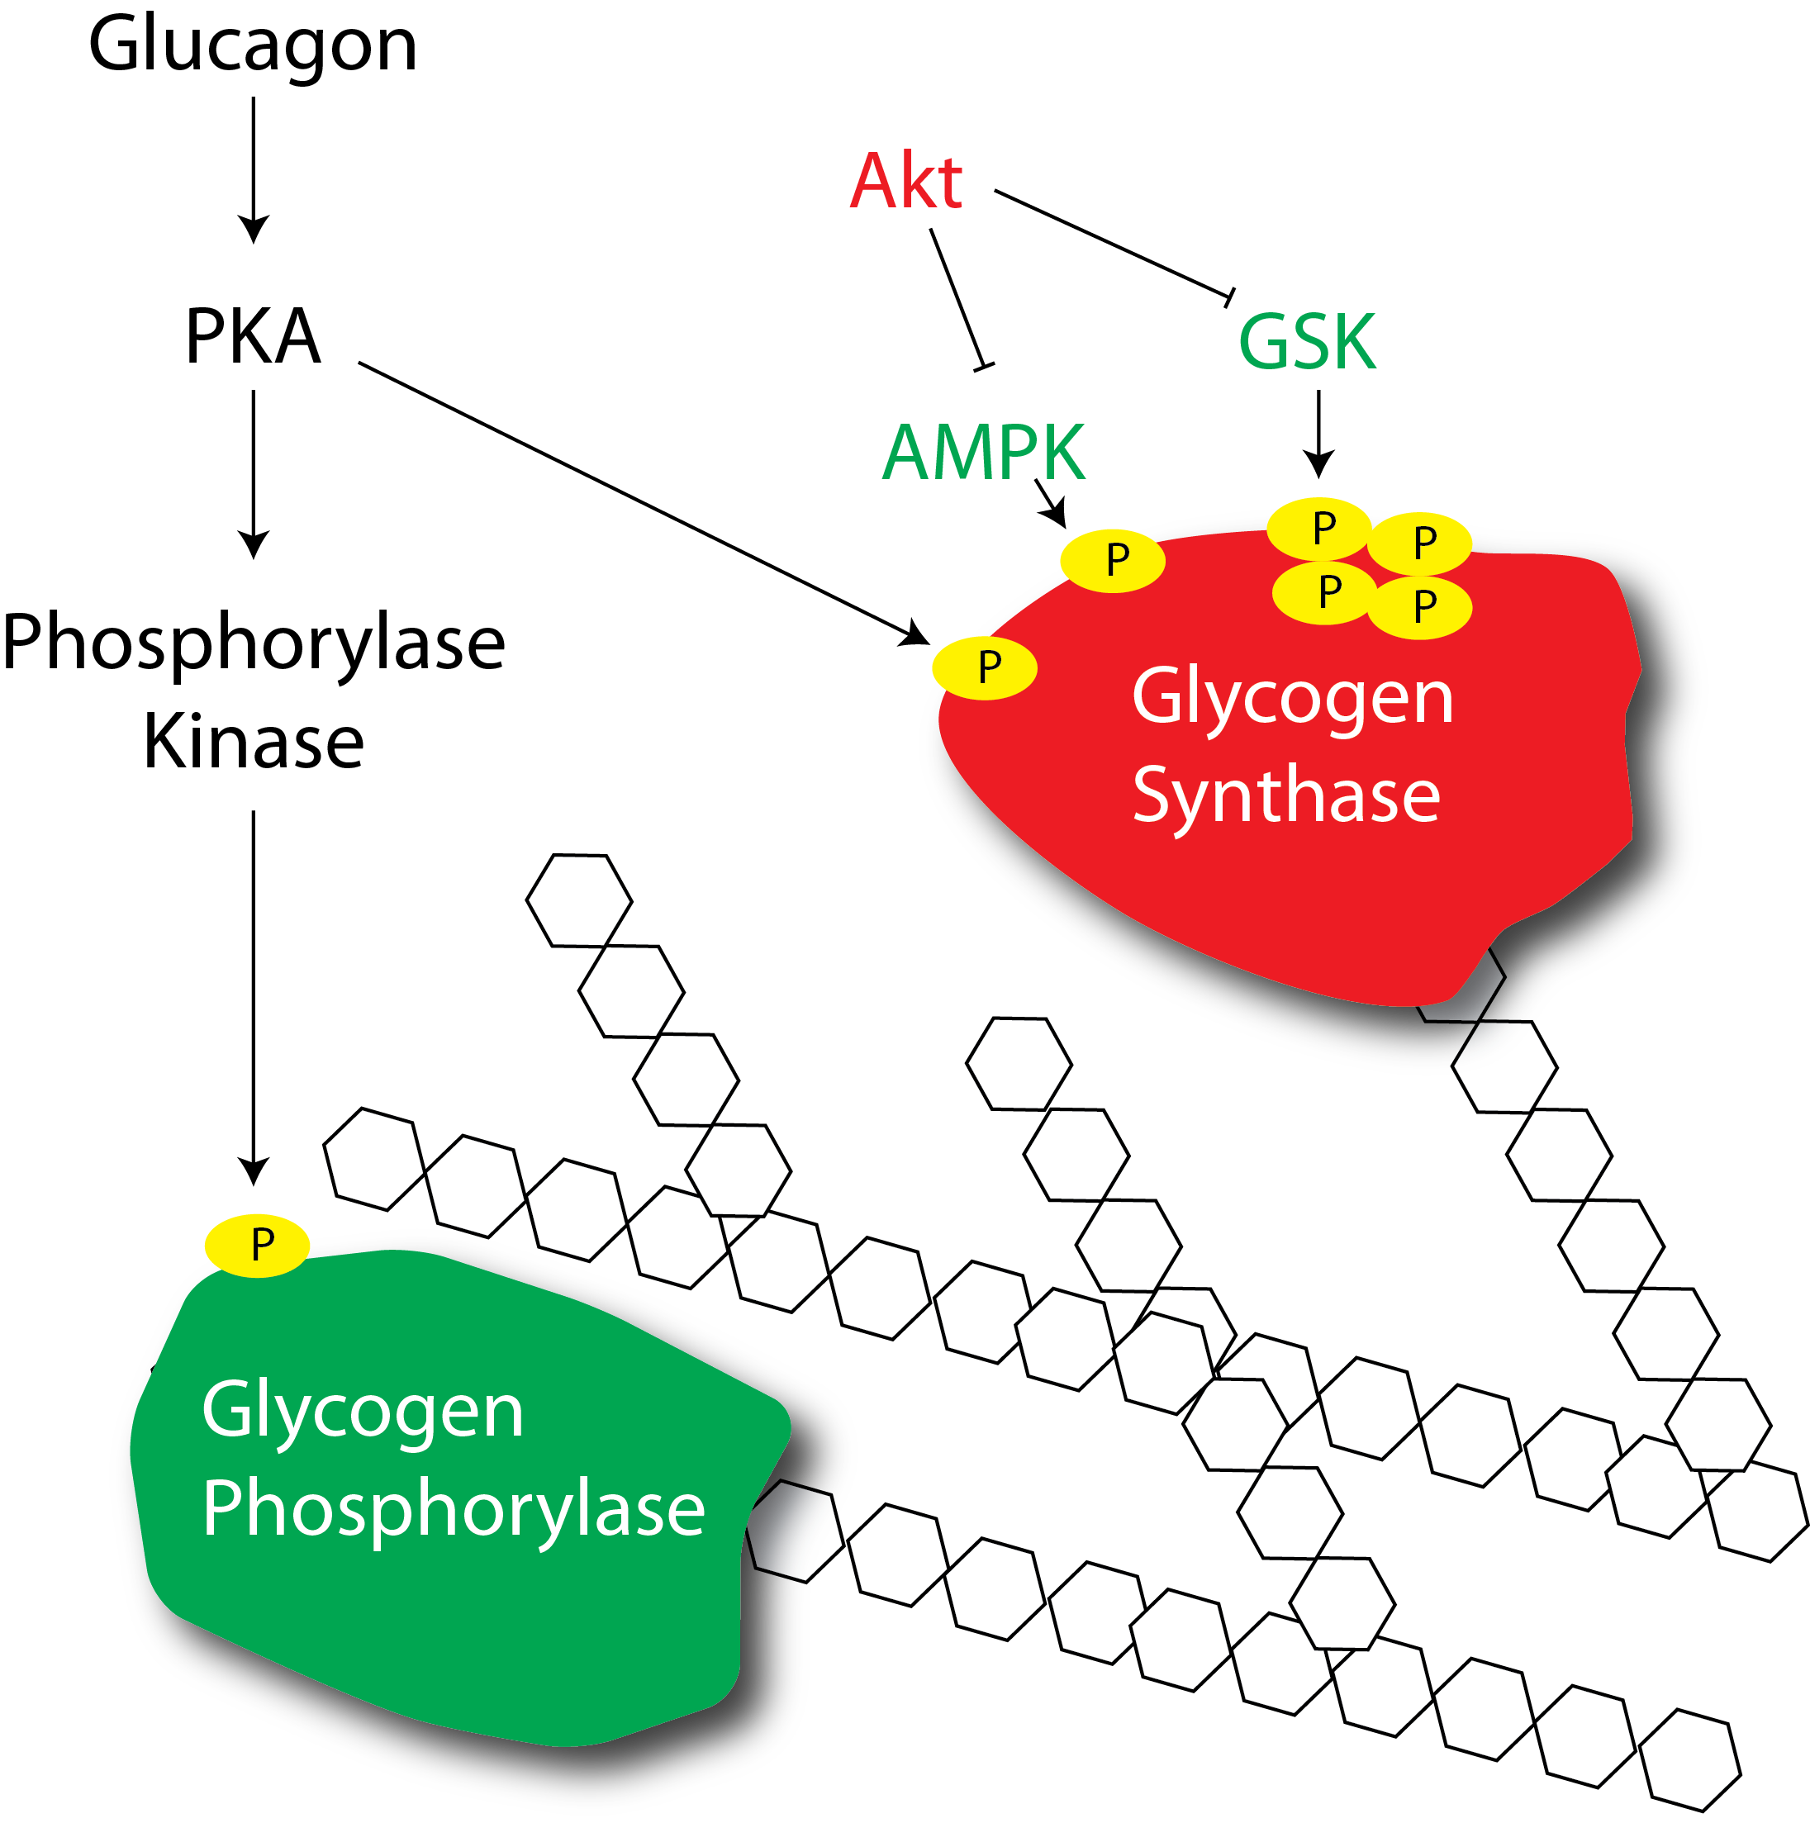
How does glucagon regulate glycogenolysis?

Slide 38
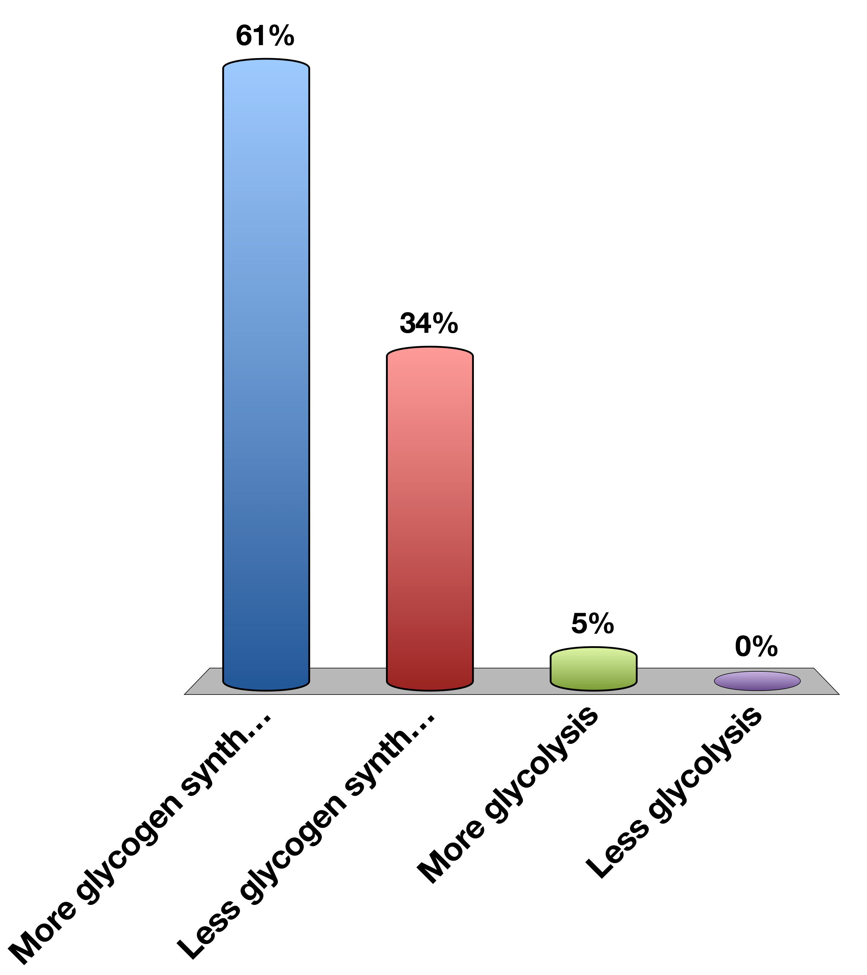
What is the effect of dephosphorylating glycogen synthase and glycogen phosphorylase?
More glycogen synthesis
Less glycogen synthesis
More glycolysis
Less glycolysis
0
Notes:
Correct answer is A

Slide 39
How does glucagon promote gluconeogenesis?
PKA
PFK-2
Notes:
Same as epinephrine
Ask, if we modulate F26P to promote gluconeogenesis, what would we want to do to it

Slide 40
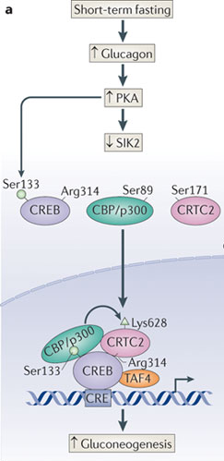
Transcriptional Regulation of Gluconeogenesis
More G6Pase, FBPase and PEPCK
Altajeros and Montminy (2008) Nat. Rev. MCB. 3:141-151

Slide 41
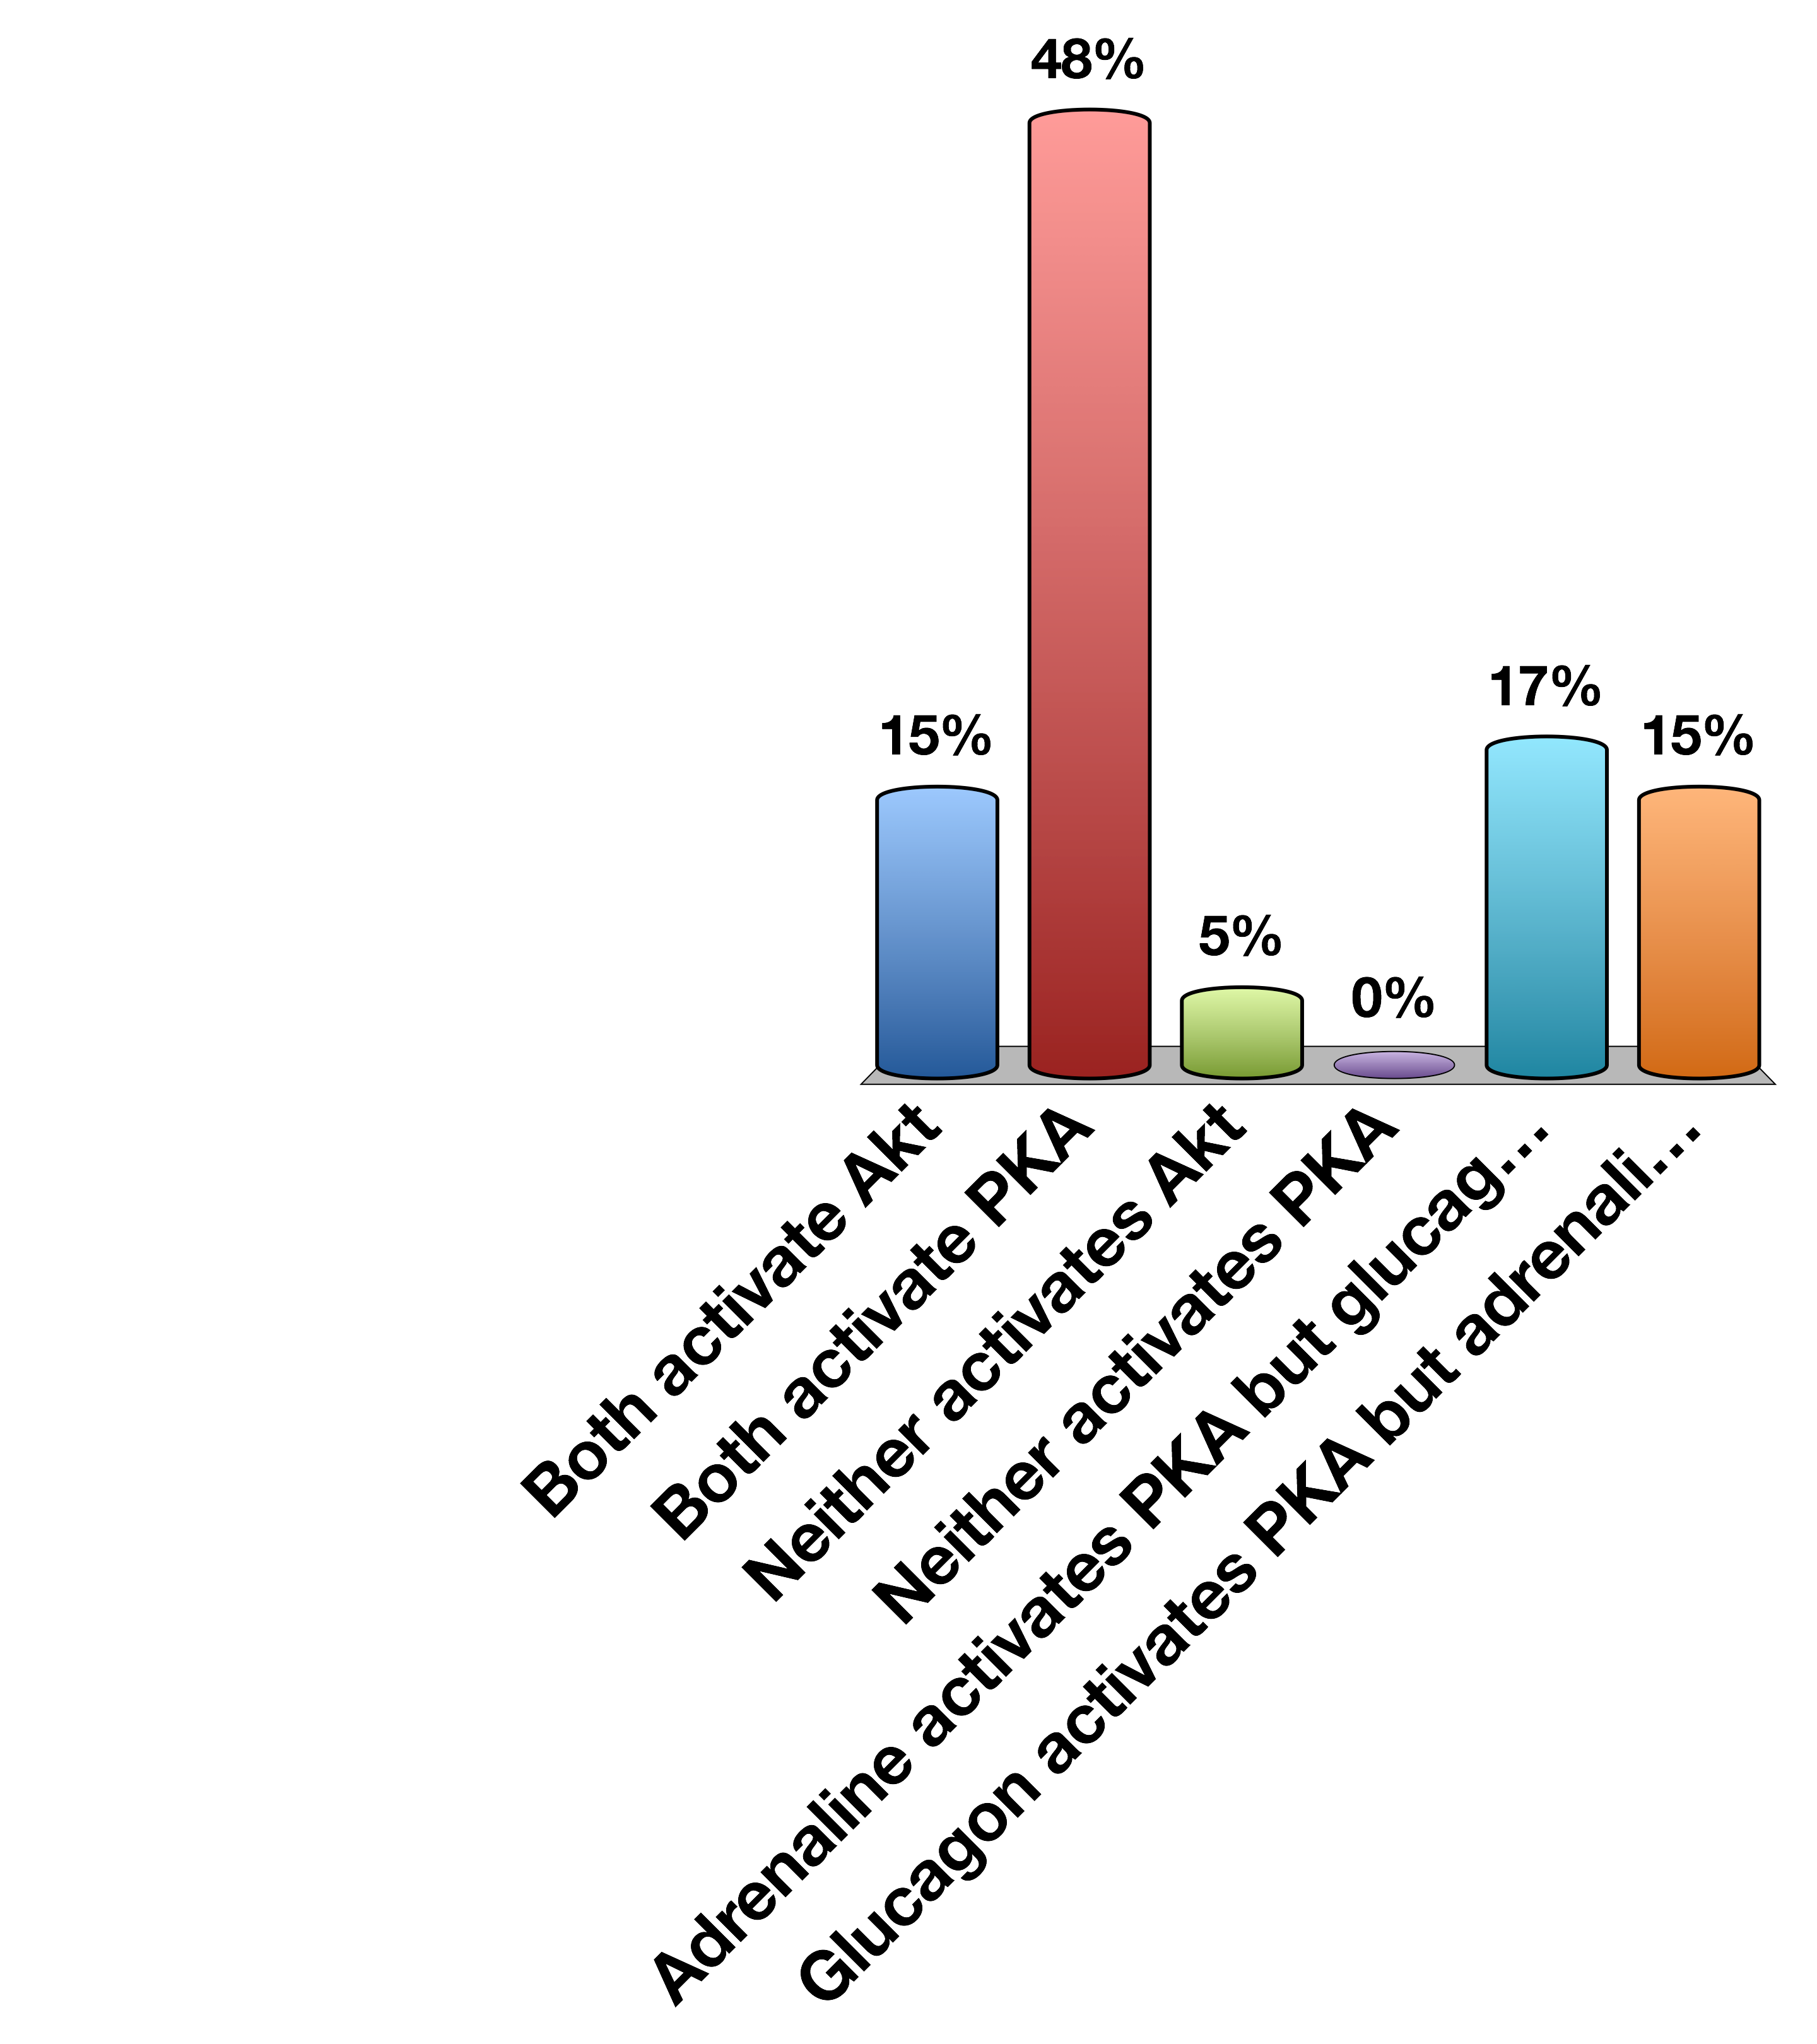
Adrenaline and Glucagon…
Both activate Akt
Both activate PKA
Neither activates Akt
Neither activates PKA
Adrenaline activates PKA but glucagon activates Akt
Glucagon activates PKA but adrenaline activates Akt
0
Notes:
Correct answer is B
Means that epinephrine and glucagon effects are identical in pancreas and liver

Slide 42
Talk amongst yourselves
What tissues would want to respond differently to adrenaline and glucagon?
Think about what each hormone is “trying” to do
Conceptually, how could this be accomplished?
Notes:
Answer is muscle, since adrenaline would stimulate glucose breakdown and contraction it would further exacerbate hypoglycemia
This is accomplished by having very little glucagon signaling in WAT/muscle

Slide 43
Glucose and Hormones After a Meal
First glucose goes up (due to the food)
Then insulin increases (in response to glucose)
This causes glucose levels to drop
At the same time glucagon levels will decrease as glucose levels are high, then increase as normoglycemia is maintained
Notes:
Draw a GTT on the board

Slide 44
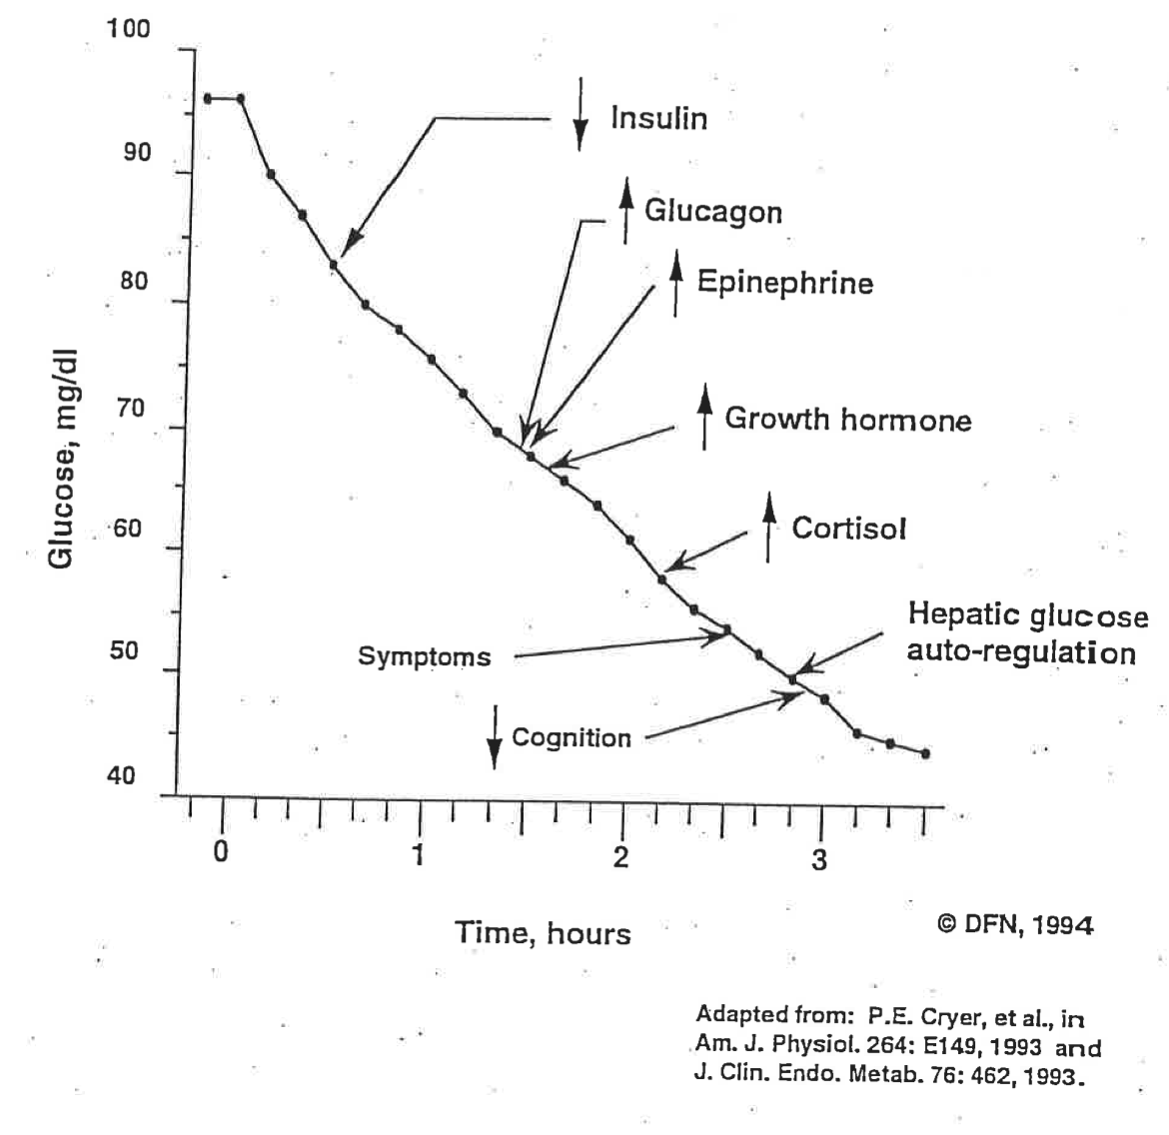
Long Term Glucoregulation

Slide 45
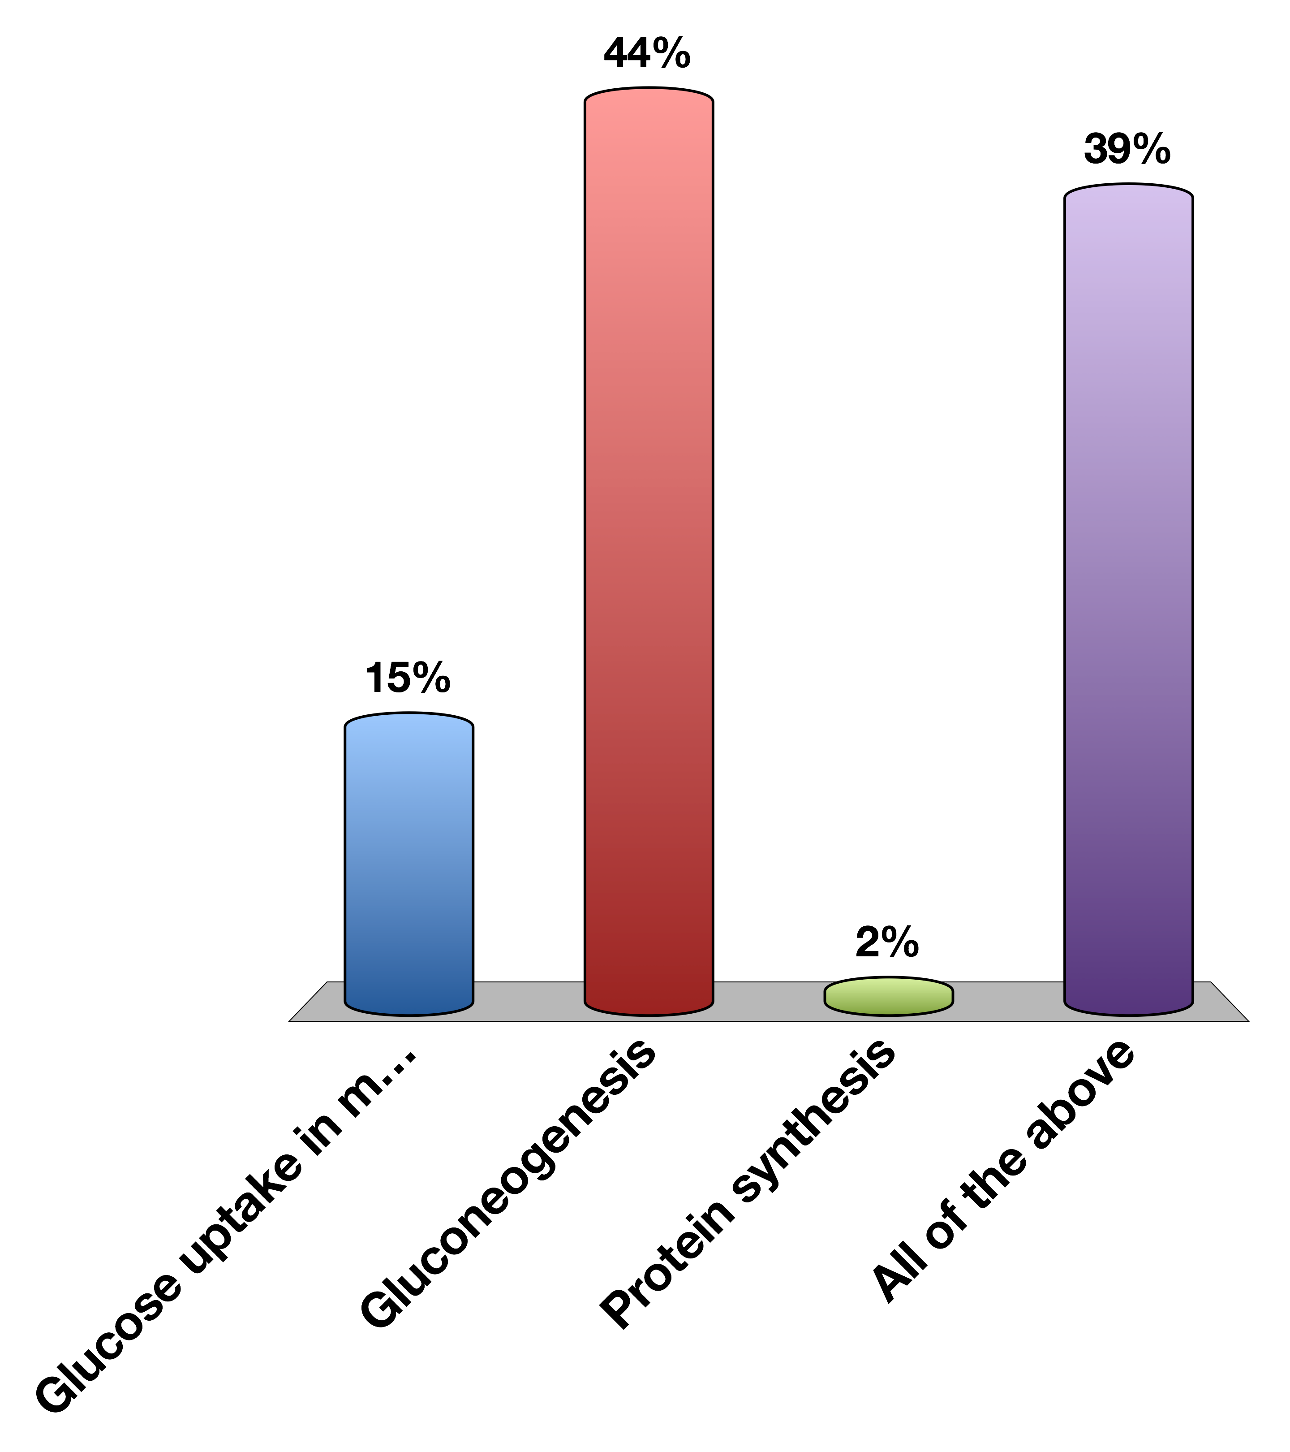
Which process does cortisol accelerate
Glucose uptake in muscle
Gluconeogenesis
Protein synthesis
All of the above
0

Slide 46
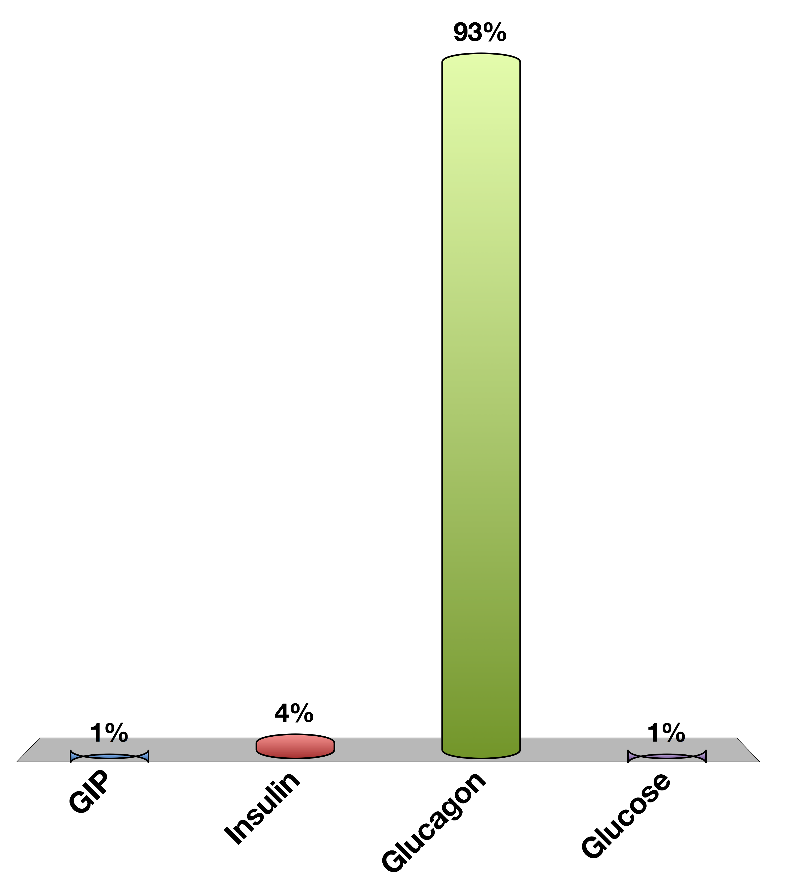
During Fasting Which Is Elevated
GIP
Insulin
Glucagon
Glucose
0
Notes:
C is correct

Slide 47
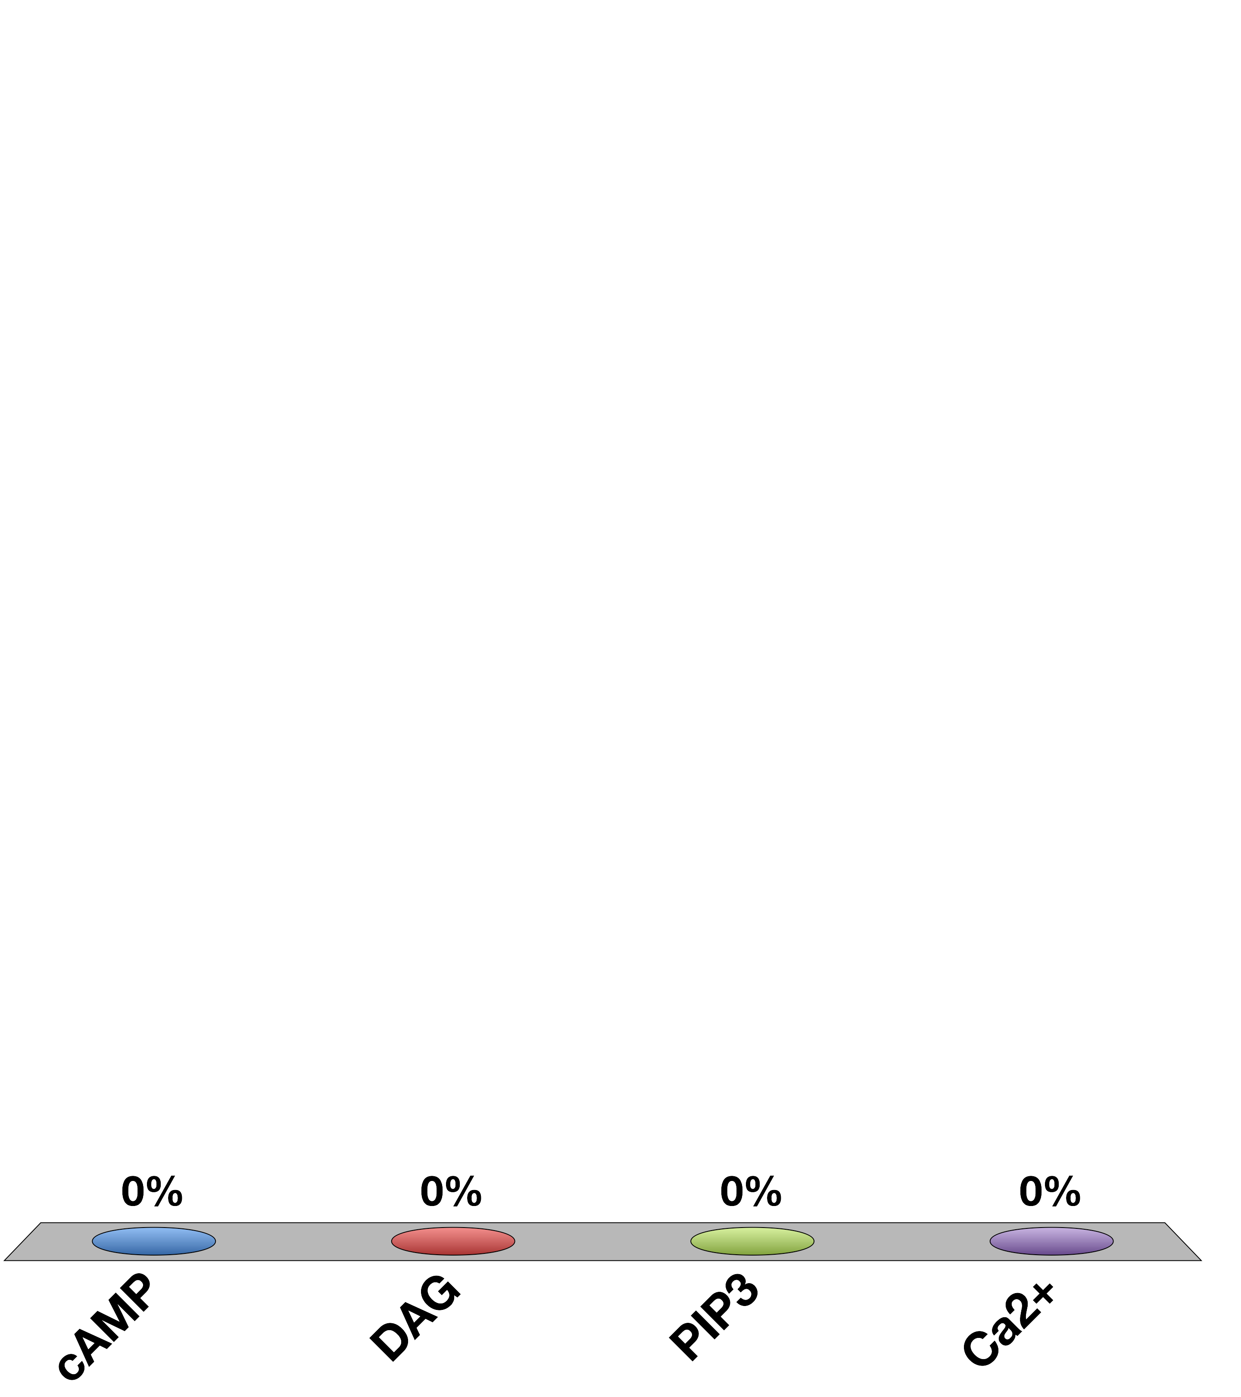
Which is the main second messenger in glucagon signaling
cAMP
DAG
PIP₃
Ca²⁺
15

Slide 48
Pathophysiology of Glucose Control

Slide 49
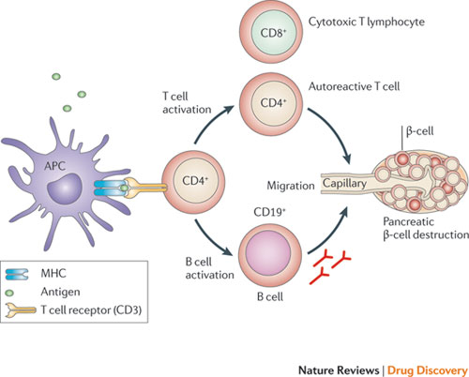
Type I Diabetes Results from a Loss of Beta Cells

Slide 50
Type II Diabetes
Excessive nutrient storage
Tissues Become Insulin Resistant
Pancreas Compensates by Secreting More Insulin to Normalize Glucose
Tissues Become More Insulin Resistant
Eventually Pancreas Fails to Compensate
Hyperglycemia

Slide 51
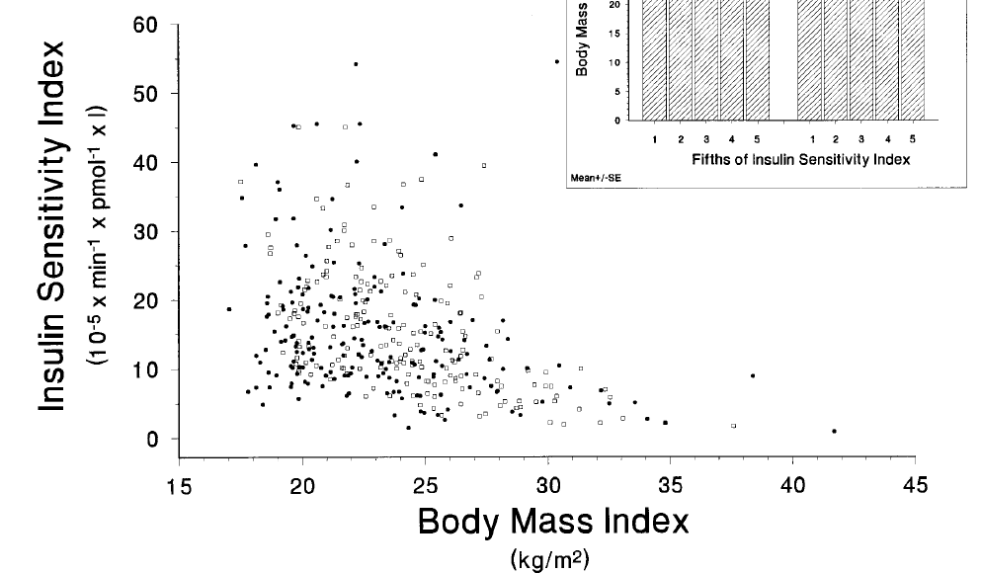
Why Is There Insulin Resistance
Negative feedback loops are common in most endocrine organs
A mechanism to avoid excessive nutrient storage
The “Thrifty Genotype” Hypothesis
Clausen et al. 1996 J. Clin. Invest. 98:1195–1209
Notes:
Spend some time discussing what would happen Insulin resistance and pancreatic responses underlie progression from weight gain to diabetes
if someone is obese but resistant to diabetes

Slide 52
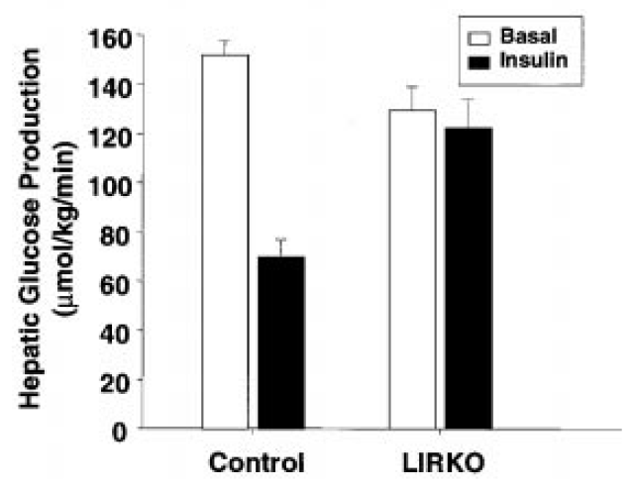
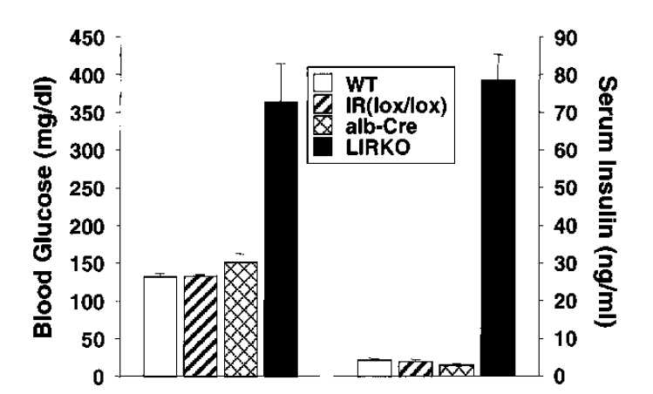
Liver Insulin Receptor Knockout
Michael et al. (2000) Mol Cell 6:87-97

Slide 53
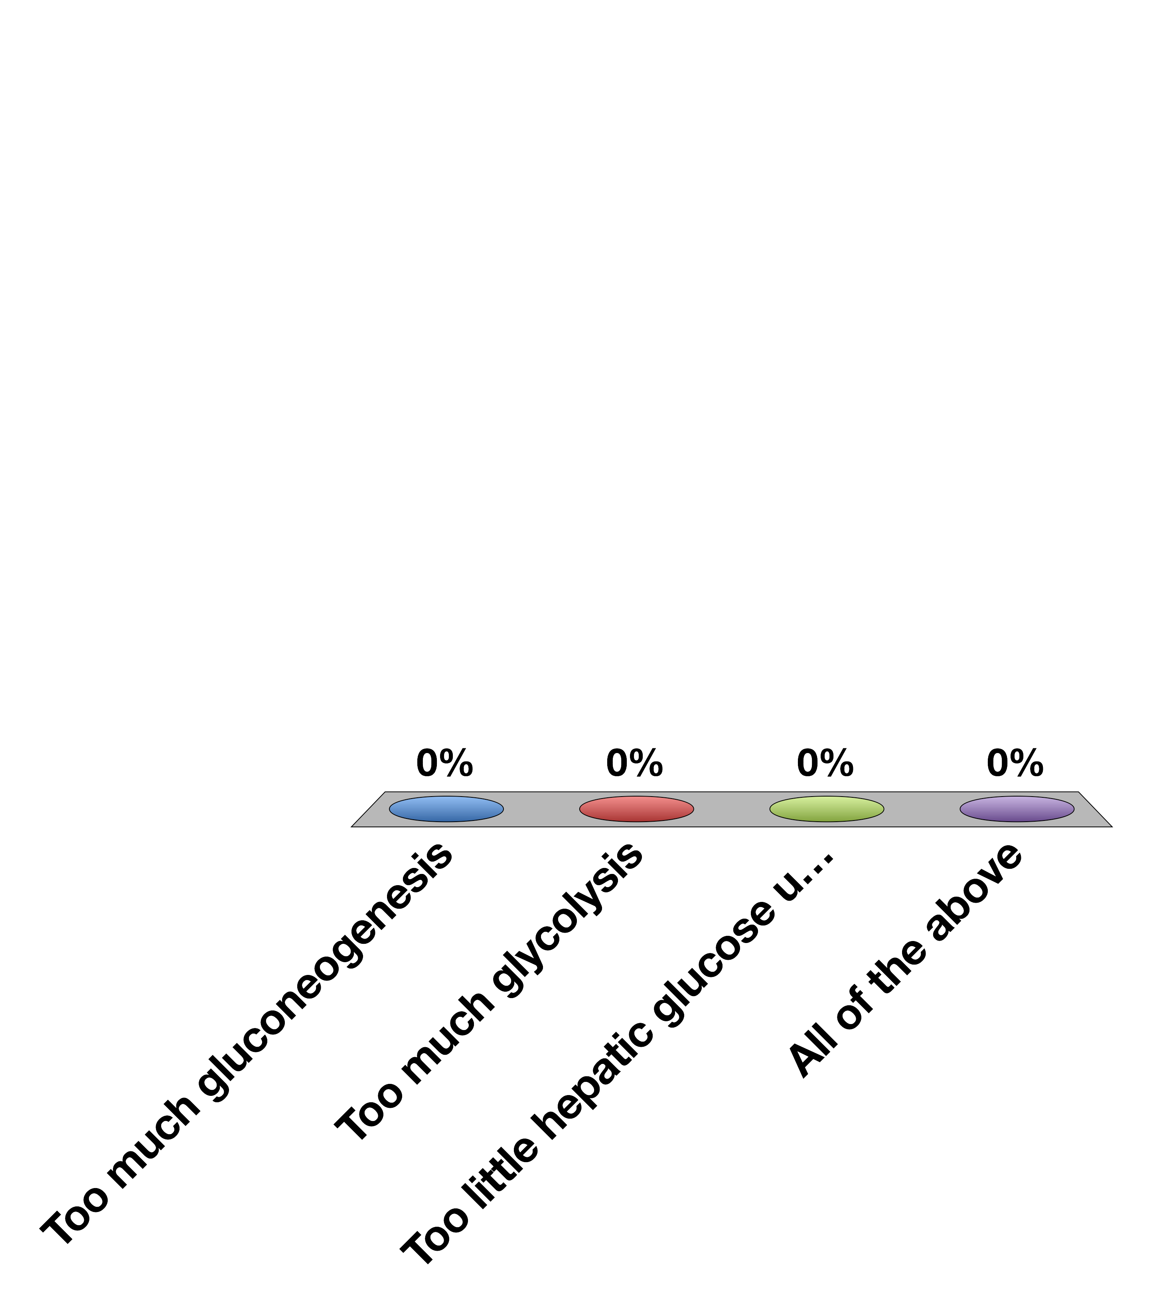
Why would liver insulin resistance cause hyperglycemia
Too much gluconeogenesis
Too much glycolysis
Too little hepatic glucose uptake
All of the above
30

Slide 54
Mechanisms of Insulin Resistance
Overnutrition induced insulin resistance
Lipid mediated insulin resistance
Inflammation associated insulin resistance

Slide 55
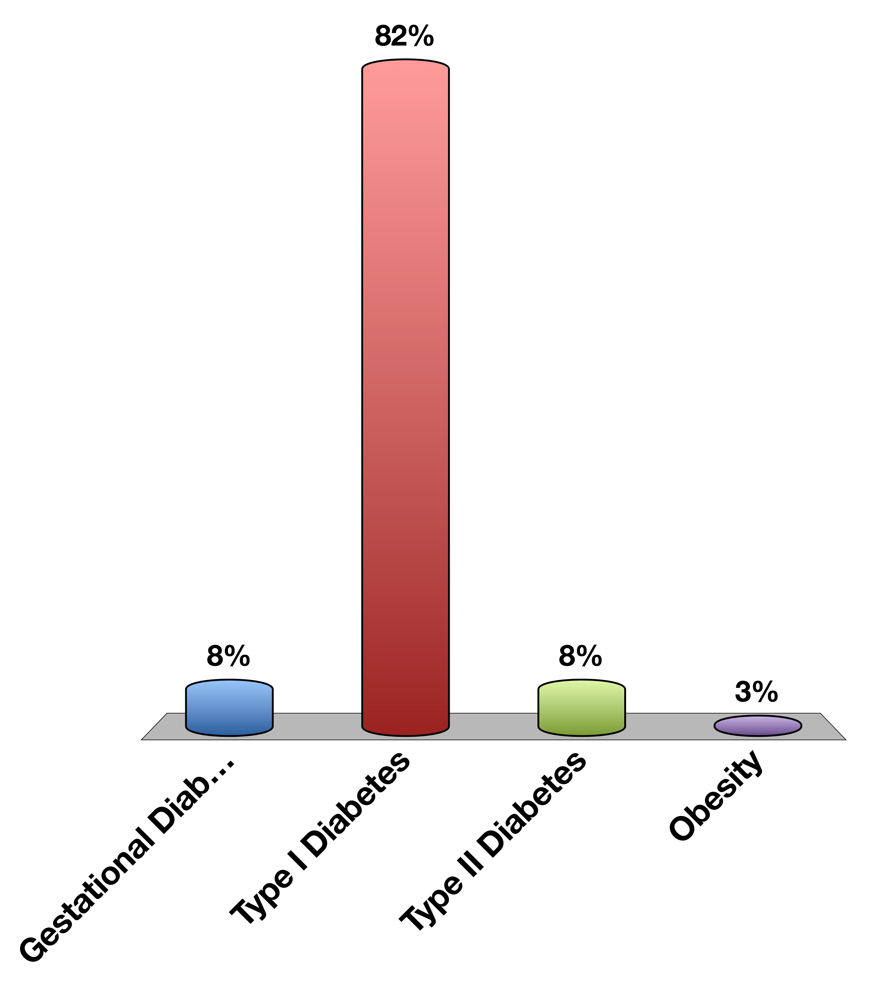
A lack of insulin production causes
Gestational Diabetes
Type I Diabetes
Type II Diabetes
Obesity
7
Notes:
Correct answer is B

Slide 56
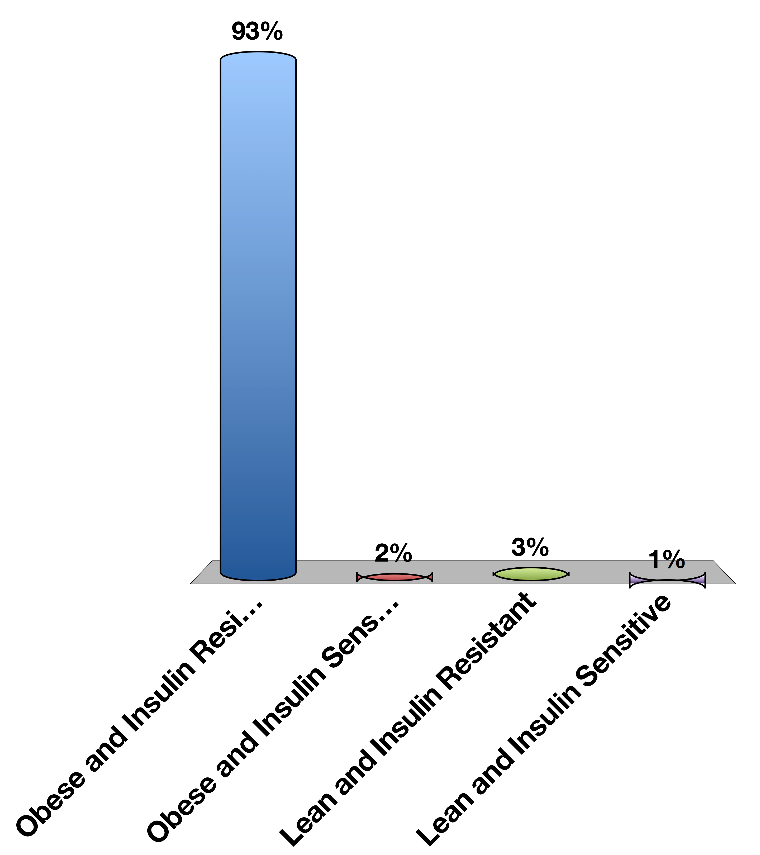
Type II Diabetics Tend To Be…
Obese and Insulin Resistant
Obese and Insulin Sensitive
Lean and Insulin Resistant
Lean and Insulin Sensitive
0
Notes:
Correct answer is A

Slide 57
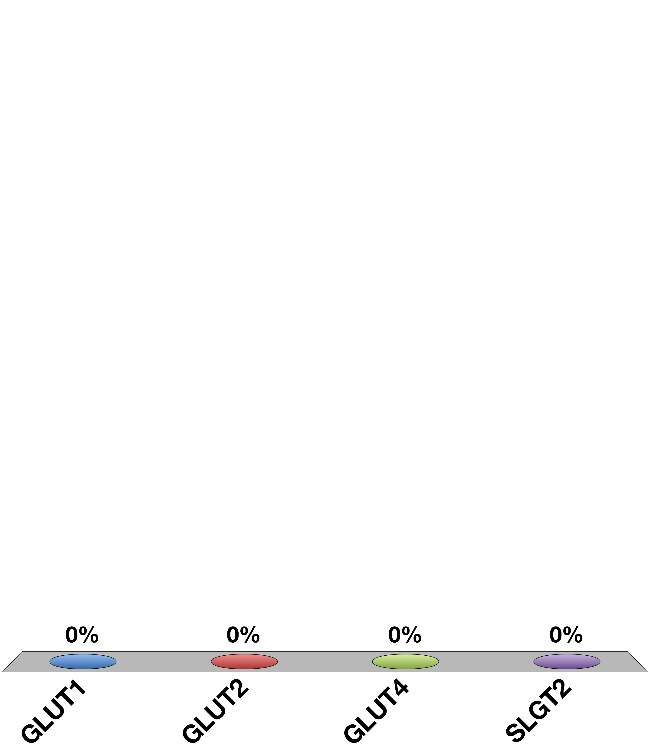
What is the main insulin responsive glucose transporter
GLUT1
GLUT2
GLUT4
SLGT2
30

Slide 58
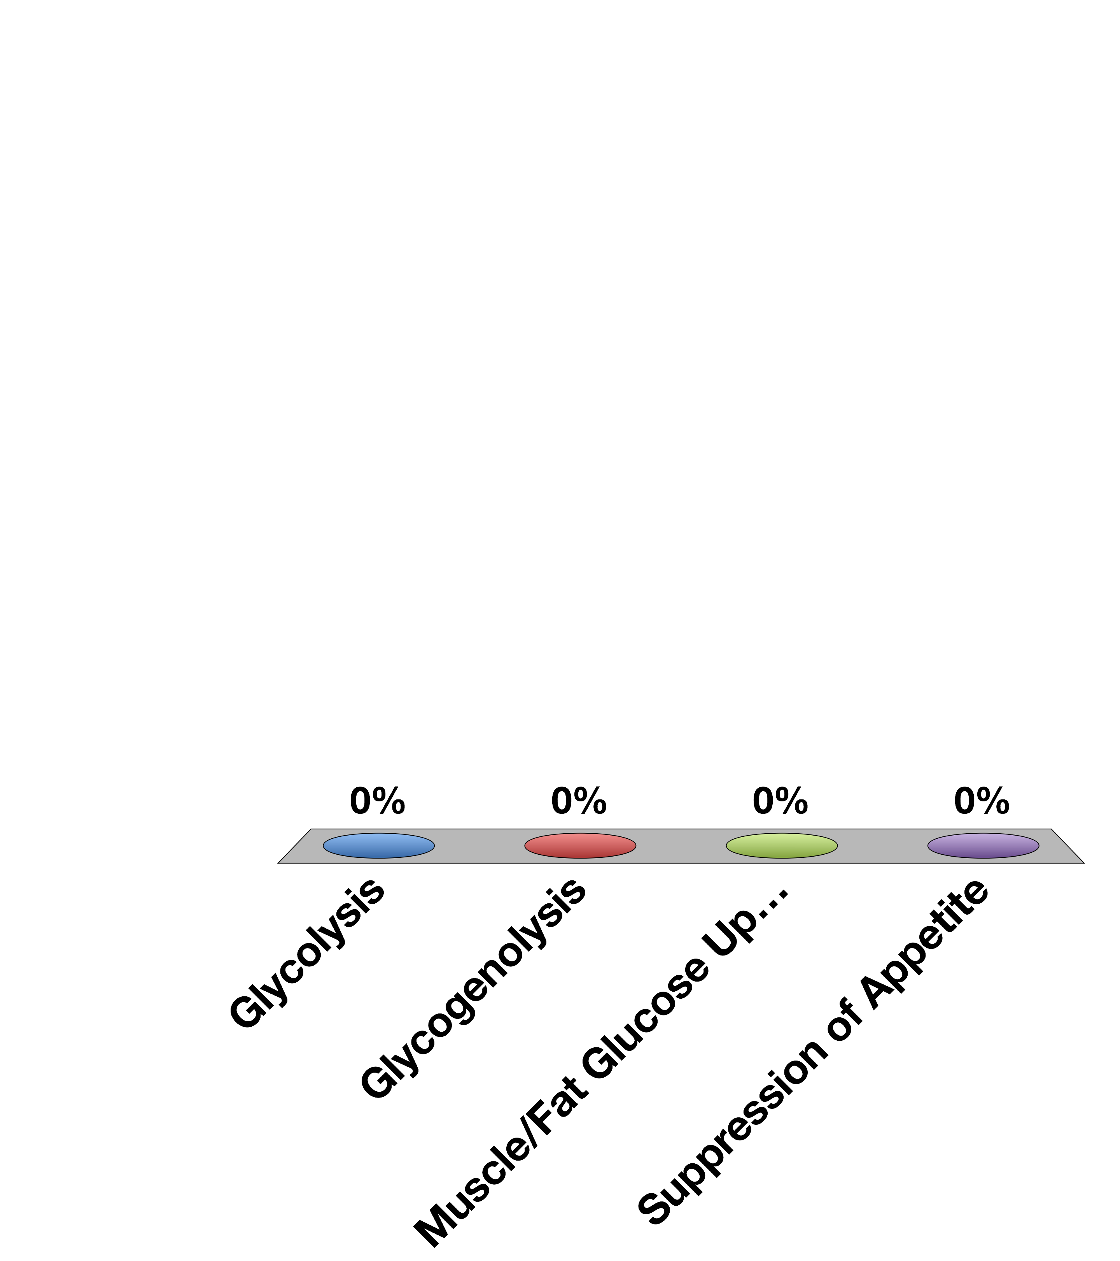
Which of the following will increase plasma glucose
Glycolysis
Glycogenolysis
Muscle/Fat Glucose Uptake
Suppression of Appetite
30
Notes:
Correct answer is B

Slide 59
Learning Objectives
Name the cell types of the Islets of Langerhans and name the hormones secreted by them.
Describe the main targets and functions of glucagon.
List the major factors that stimulate or inhibit glucagon and insulin.
Describe the important physiological roles of insulin.
List the major actions of insulin in muscle, adipose tissue, and liver.
Explain briefly the mechanism of glucose uptake into the muscle.
Name the tissues in which insulin facilitates glucose uptake and those in which insulin does not facilitate glucose uptake.
List the major factors that stimulate or inhibit insulin secretion.
Draw an oral glucose tolerance test (oGTT) (glucose, insulin, and glucagon levels) and and describe what is occurring and why. Explain how the two hormones act to promote glucose homeostasis in the plasma.
State which nutrient storages are preferably used for short-term regulation of energy metabolism if no nutrients are available from the GI tract.
Discuss the hormones involved, fuel storage capacity, fuel storage consumption, and glucose (or fatty acid) levels during 1) the postprandial period, 2) the post-absorptive period, 3) fasting.
List the insulin-counteracting hormones and their roles in glucose homeostasis. Discuss the hormones involved in minute-to-minute regulation and long-term regulation of glucose homeostasis.

Slide 60
Regulation of Appetite

Slide 61
Learning Objectives
Describe the appetite-regulating hormones secreted from the gut, how they are regulated and under what conditions they are released.
Describe the AgRP/POMC circuit and its relationship to both circulating factors and neuropeptides.
Understand the relationship between adipose mass and appetite regulation, including how adipokines are regulated and what role they play.
List the effects of insulin on appetite and what the neurological targets of insulin are.
Describe the role of the blood-brain barrier in the regulation of appetite and how it is altered in obesity.
Describe how hypothalamic feeding circuits integrate with other pleasure and reward circuits in the brain.
Explain how neuroendocrine obesity differs from idiopathic obesity and how they might be treated in different ways.

Slide 62
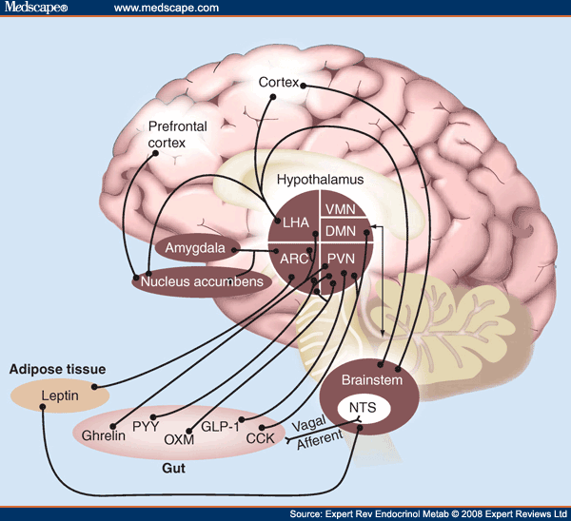
The Central Role of The Hypothalamus

Slide 63

The POMC/AgRP Circuit
Promotes
Eating
Suppresses
Appetite
Notes:
Two populations of neurons in the arcuate nucleus.
Normally AgRP neurons are on, this inhibits POMC neurons and prevents downstream effects on food seeking behavior
AgRP neurons can be turned off, or POMC neurons can be turned on via external signals

Slide 64

Glucose Sensing Neurons
AgRP
POMC
AgRP
POMC
Notes:
In the subfornicular organ, area postrema and the hypothalamus

Slide 65

Hormonal Control of Appetite
Notes:
Think about it this way… AgRP neurons like to be on, and when they are on they increase appetite.

Slide 66
Insulin Regulation of Appetite
Acts on both AgRP and POMC Neurons
Enhances excitability of POMC but inhibits AgRP Neurons -> Decreases appetite
Requires transport across blood-brain barrier
Notes:
anorexigenic

Slide 67

Brain insulin resistance would lead to
Increased appetite
Decreased appetite
Hypoglycemia
0

Slide 68


Leptin and the Ob/Ob Mouse
ob/ob mouse
db/db mouse

Slide 69
The Leptin/Leptin Receptor Genes
Leptin
Receptors in
Hypothalamus
Reduced
Food
Intake
Leptin
Release
Notes:
ob gene is leptin
db gene is the leptin receptor

Slide 70

Why would Lep or LepR mutant mice become obese
Elevated insulin sensitivity
Elevated appetite because too much leptin signaling
Elevated appetite because no leptin signaling
Reduced appetite because not enough leptin signaling
Reduced appetite because no leptin signaling
0
Notes:
Correct answer is C

Slide 71
Leptin Summary
What chemical type? | Protein
Where is it made? | Adipocytes
What causes its release? | Fat Expansion
What are its receptors? | LepR (JAK/STAT)
What tissues does it affect? | Brain | Activates POMC, Inhibits AgRP -> Reduced Food Uptake
 | Adipose, Liver, Muscle | Fat Oxidation
How does it get turned off? | Receptor desensitization, reduced BBB transport
Notes:
Talk about negative feedback and why leptin therapy dosent work

Slide 72


Leptin as a Potential Weight Loss Drug?

Slide 73

Ghrelin, the Hunger Hormone

Slide 74
Ghrelin Activates AgRP Neurons
Promotes
Eating
Suppresses
Appetite

Slide 75
Ghrelin Summary
Where is it made? | Protein
What causes its release? | Less Stomach Stretch
What are its receptors? | GHSR (Gq-GPCR) | AgRP Neurons
What tissues does it affect? | Brain | Activtes AgRP-> Increased Food Intake
How does it get turned off? | Receptor desensitization, reduced BBB transport, food intake -> stomach stretch
Notes:
Talk about negative feedback and why leptin therapy dosent work

Slide 76

PYY

Slide 77
PYY Summary
Where is it made? | PYY
What causes its release? | Nutrients in Colon
What are its receptors? | Y1R | AgRP/POMC Neurons
What tissues does it affect? | Brain | Decreases Food Intake
 | GI Tract | Smooth Muscle Contraction (GI Motility)
How does it get turned off? | Receptor desensitization, food moves out of GI
Notes:
Talk about negative feedback and why leptin therapy dosent work

Slide 78

A mouse with no Leptin Receptor
Would overeat because it cant respond to leptin
Would not eat because it cant respond to leptin
Would over-eat because it responds too strongly to leptin
Would not eat because it responds too strongly to leptin
26

Slide 79

Which hormone stimulates appetite
Insulin
Leptin
Ghrelin
PYY
0

Slide 80

Obesity and the BBB
Leptin, Ghrelin and Insulin transport is reduced.
PYY and Adrenaline permeability is not reduced
Banks W a., DiPalma CR, Farrell CL (1999) Impaired transport of leptin across the blood-brain barrier in obesity. Peptides 20: 1341–1345. doi:10.1016/S0196-9781(99)00139-4.

Slide 81
Monogenic Forms of Obesity
Gene | Function | Incidence
LEP | Leptin -> Reduces Appetite | Rare
LEPR | Leptin Receptor | 2-5% of obese individuals
POMC | MSH/ACTH | Rare
MC4R | MSH Receptor | 2-5% of obese individuals
BDNF | Downstream of MC4R | Rare
NTRK2 | BDNF Receptor | Rare
How could a leptin deficient patient be treated that might be different from how a idiopathically obese patient is treated?

Slide 82
Learning Objectives
Describe the appetite-regulating hormones secreted from the gut, how they are regulated and under what conditions they are released.
Describe the AgRP/POMC circuit and its relationship to both circulating factors and neuropeptides.
Understand the relationship between adipose mass and appetite regulation, including how adipokines are regulated and what role they play.
List the effects of insulin on appetite and what the neurological targets of insulin are.
Describe the role of the blood-brain barrier in the regulation of appetite and how it is altered in obesity.
Describe how hypothalamic feeding circuits integrate with other pleasure and reward circuits in the brain.
Explain how neuroendocrine obesity differs from idiopathic obesity and how they might be treated in different ways.

Slide 83
Endocrine Control Systems
Define endocrine, paracrine, autocrine, and exocrine systems, define neuro-secretory cells by giving a few examples.
List major chemical categories of hormones and give several examples that belong to each class.
List important factors that determine hormone levels in circulation.
Explain cellular actions of hormones via membrane and nuclear receptors, including an understanding of the rates by which these processes can affect cells.
Define basal secretion and stimulated secretion of endocrine glands.
Describe negative and positive feedback system using an example.
Explain with examples neuroendocrine integration.

Slide 84
Hypothalamus and Pituitary
Recall anatomical, biochemical, and functional evidence showing intimate relationships between hypothalamus and pituitary.
Describe how hormones are sensed by the neurons of the hypothalamus, and the role that the blood brain barrier and transport mechanisms play.
Recall how the central nervous system can integrate with the hypothalamus and modify both hormonal secretions and executive function.
Describe the differences in how hypothalamic signals are passed to the posterior and anterior pituitary glands.
List the known hypothalamic hormones which cause release (and release-inhibition) of anterior pituitary hormones, including their acronyms.
Name two major posterior pituitary hormones, their chemical category, and succinctly describe their secretory mechanism.
Describe cellular actions of vasopressin in terms of site of actions, receptors, and cellular signals.
Discuss briefly aquaporin water channels and relation to vasopressin.
Predict what the changes are expected in urine volume and osmolality and in ECF volume when vasopressin synthesis or secretion is severely impaired. Predict what will happen to water intake. Explain why there can be transient diabetes insipidus following a whiplash injury, and the rationale for therapy during this time.
Describe the control of vasopressin release.
Describe the function of oxytocin with respect to delivery and lactation.

Slide 85
Adrenals and Stress
Name three zones in the adrenal cortex and major regulator(s) of each zone.
Name three steroidogenesis pathways and their major products.
Explain briefly the physiological mechanism of adrenogenital syndrome.
Describe the physiological actions and roles of aldosterone.
Explain briefly the renin-angiotensin system.
Describe the negative feedback regulation of aldosterone and its relationship to blood volume/blood pressure homeostasis.
Describe hepatic and extrahepatic metabolic actions of glucocorticoids. Discuss their relationship.
State the major findings caused by adrenal hypersecretion of mineralocorticoids.
State the major findings caused by adrenal hypersecretion of glucocorticoids.
Name the major hormones secreted from the adrenal medulla. Discuss the differences of epinephrine (epi) and norepinephrine (NE) in cardiovascular actions (physiological levels).
List the major metabolic actions of catecholamines.
Contrast the thresholds for actions vs. plasma levels of epi and NE under common conditions, like exercise, and in the disease pheochromocytoma

Slide 86
Growth
List the hormones important for growth at key times in a person's life.
Describe the functions of human growth hormone on growth (bones and soft tissues), and on metabolism, and the regulation of its secretion. Explain what 'rhGH' means.
State the "dual effector hypothesis" for GH actions, and the relative roles of GH and IGF-1 in growth control.
Describe the interactions among all the key growth-regulating hormones at key times of a person's life: in utero, neonatally, childhood, puberty, adulthood, and senescence.
Describe the daily regulation of GH levels and the physiological relevance of these cycles.

